Slide 1
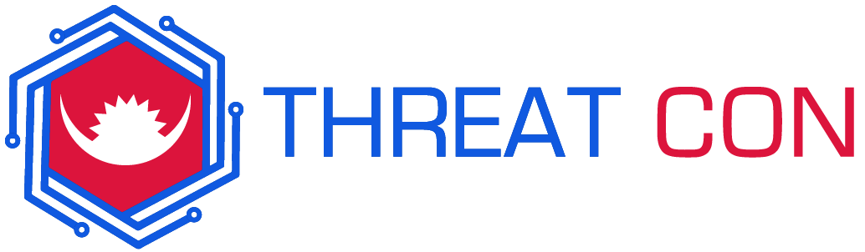

Cybersecurity and Supply Chain Risk Management: Best Practices for Procurement
By Touhid Shaikh From Securityium
www.securityium.com

Slide 2
Introduction

Slide 3


About Me
Red Teamer and Bug Hunter
Exploit Developer in Metasploit Framework (Contribution)
Author in CIS Benchmark
Love to Code in Python
CTF Player (Agent22) and CTF Maker
~$ whoami

Slide 4
Agenda
What is Supply Chain Attacks?
Attack Vectors and Target Industries
Why Supply Chain Risk Management Matters?
Risks Associated with Third-Party Vendors.
Case Study 1 and Case Study 2
Evaluating Cybersecurity Risks
Vendor Risk Assessment
Controlling Supply Chain Risk Frameworks
Best Practices for Risk Reduction
Vendor Relationship Management
Legal and Regulatory Requirements
Implementing Effective Procurement Strategies
Recent Developments in Supply Chain Risk Management
Q&A

Slide 5
What is Supply Chain Attacks?
Supply chain attacks are an emerging threats that target software developers and suppliers. The goal is to access source codes, build processes, or update mechanisms by infecting legitimate apps to distribute malware.
Notes:
A software supply chain attack refers to a cyberattack that focuses on an organization's software or service providers within its digital supply chain.
The main objective of these attacks is to breach the target organization by exploiting vulnerabilities in the systems of its vendors or suppliers. This enables attackers to gain unauthorized access to sensitive data and resources, disrupt operations, or harm the organization's reputation.

Slide 6
Attack Vectors
Infrastructure Build or Update Compromise
Certificate Theft or Developer Account Breach
I
C
Infra
Attackers steal code signing certificates or use compromised developer accounts to sign malicious applications under the developer company's identity.
Attackers compromise software-building tools or update infrastructure.
CT or DAB
(Hard | Soft) ware
Pre-Installed
Hardware or Software Compromise
Pre-Installed Device Malware
H
P
Attackers compromise specialized code embedded in hardware or firmware components.
Malware is pre-installed on device storage, including cameras, USB drives, recorders, phones, and more.

Slide 7

Target Industries
Government and Defense
Energy and Utilities
Banking and Finance
HealthCare
Telecommunications
Small and Medium-sized Enterprises (SMEs)
..ETC
Notes:
Supply chain attacks can target various industries, and virtually any sector that relies on a complex network of suppliers, vendors, and partners is susceptible to such attacks. Here is a list of industries that are commonly targeted in supply chain attacks:

Slide 8
Why Supply Chain Risk Management Matters ?
Increasing Reliance on Vendors
Cybersecurity Implications
Financial Consequences
Regulatory Compliance

Slide 9
Risks Associated with Third-Party Vendors
Cyberattacks
Vendors may be targeted by cybercriminals, and if successfully breached, this can serve as a gateway for attackers to infiltrate the organization's network.
C
Third-party vendors play a crucial role in many businesses, providing goods, services, and technologies that organizations may not be able to develop or manage in-house.
D
M
Malware and Ransomware
Data Breaches
Vendors often have access to an organization's sensitive data. If a vendor's security measures are inadequate, it can lead to data breaches and the exposure of confidential information
Malicious software introduced through a vendor's systems can spread throughout the organization's network, causing disruptions and financial losses.

Slide 10

Case Study 1
SolarWinds
Year 2020
Notes:
2020: SolarWinds Cyberattack
Description: The SolarWinds cyberattack, also known as the Sunburst attack, targeted the supply chain of SolarWinds, a software company. Attackers compromised the company's software updates to distribute a backdoor known as "Sunburst" to thousands of customers, including government agencies and major corporations.
More than 18,000 customers of SolarWinds had applied the Sunburst update, which then allowed the remote access trojan to infect all their customer systems and networks
The attack involved hackers compromising the infrastructure of SolarWinds, a company that produces a network and applications monitoring platform called Orion, and then using that access to produce and distribute trojanized updates to the software's users.
Impact: This highly sophisticated attack had far-reaching consequences, compromising sensitive government and corporate networks and resulting in significant data breaches.

Slide 11
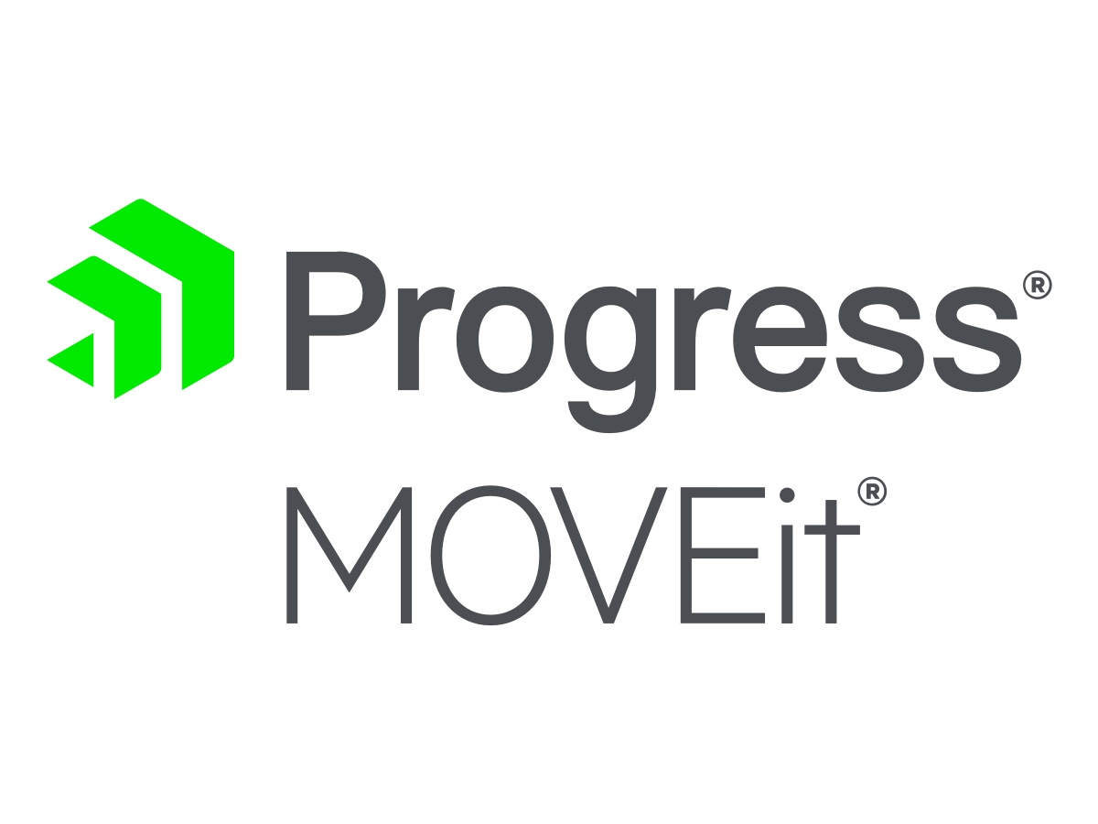
Case Study 2
MOVEit
Year 2023
Notes:
https://www.cybersecuritydive.com/news/moveit-breach-timeline/687417/
More than 1,000 organizations have been impacted by Clop’s mass exploitation of a zero-day vulnerability that Progress Software first disclosed in late May, according to threat analysts and researchers. Five additional vulnerabilities in the file-transfer service have subsequently been discovered.
MOVEit is an approved and accredited file-transfer service that meets regulatory compliance requirements for multiple government agencies and highly regulated industries. These auditor and government-backed certifications made it a widely used service for organizations with sensitive data.
The financially motivated Clop ransomware group is responsible for two of these supply-chain attacks, including a zero-day vulnerability in Fortra’s GoAnywhere file-transfer service the group exploited in March.

Slide 12
Supply Chain Attacks
2017
2018
2019
2020
2021
2022
2023
NotPetya (a.k.a. Petya, ExPetr)
Magecart Attacks
Kaseya Ransomware Attack
3CX
ASUS Live Update Hack
SolarWinds Cyberattack
Log4j

Slide 13
Evaluating Cybersecurity Risks
Identify Assets and Data
Calculate Risk Likelihood
Identify Threats
Determine Impact
Assess Vulnerabilities
Risk Assessment

Slide 14
Vendor Risk Assessment
Inventory of Vendors
Collect Vendor Information
Begin by creating a comprehensive inventory of all the vendors, suppliers, and third-party service providers with whom your organization interacts.
Request relevant information and documentation from the vendors.
Categorize Vendors
Vendor Interviews
Categorize your vendors based on their importance and the level of risk they pose to your organization.
Conduct interviews or discussions with vendor representatives to gain a deeper understanding processes.
Define Assessment Criteria
Risk Assessment and Scoring
Determine the criteria and standards against which you will assess your vendors.
Evaluate the vendor's responses and information collected against your assessment criteria.
And others

Slide 15
Controlling Supply Chain Risk Frameworks
ISO 28000
CIS Controls for Supply Chain Security
ISO 28000 is an international standard that provides a framework for establishing, implementing, operating, monitoring, reviewing, maintaining, and improving a supply chain security management system
The Center for Internet Security (CIS) provides a set of cybersecurity controls specifically tailored for supply chain security
NIST Cybersecurity Framework
BSI Supply Chain Risk Management Standard
The British Standards Institution (BSI) has developed a supply chain risk management standard (BS 10500) that outlines best practices for identifying, assessing, and managing risks in the supply chain.
this framework provides guidelines for managing and reducing cybersecurity risk, which includes supply chain risks.

Slide 16
Best Practices for Risk Reduction
Identify and Understand Risks
Develop a Risk Management Strategy
Establish Clear Ownership
Continuous Monitoring
Crisis Management Plan
Employee Training and Awareness
Data Backup and Recovery
Compliance and Regulations

Slide 17
Vendor Relationship Management
Compliance and Governance
Financial Management
Risk Assessment and Mitigation
Performance Monitoring
Clear Contracts and Agreements
Vendor Selection and Due Diligence

Slide 18
Legal and Regulatory Requirements

Slide 19
Implementing Effective Procurement Strategies
Set Clear Objectives and Goals
Establish a Procurement Team
Supplier Selection and Evaluation
Cost Control and Risk Management
Contract Management

Slide 20
Recent Developments in Supply Chain Risk Management

Slide 21
QA

Slide 22


@touhidshaikh22
touhidshaikh
https://www.linkedin.com/in/touhidshaikh22/
Connect Me

Slide 23
Thank You

