Slide 1

Diving Into the Realm of
Source Code Review
Ananda Dhakal (@dhakal_ananda)
Notes:
Hope you are having a great time at ThreatCon
In this talk, we will be going through everything about code review for bug bounty hunters
What and why of Source Code Review
Leveraging code review for bug hunters
How to get started?

Slide 2




whoami
  Bug Bounty Hunter
  Brand Ambassador @Hacker0x01
@dhakal_ananda
Notes:
Bug bounty hunter for over 5 years
Ambassador of hackerone for nepal
You can find me on X/Twitter

Slide 3
What is
Source Code Review?

Slide 4

What is source code review?
Act of finding security bugs by looking at the source code
Notes:
You read the code
You find the bug

Slide 5
Why
Source Code Review?

Slide 6
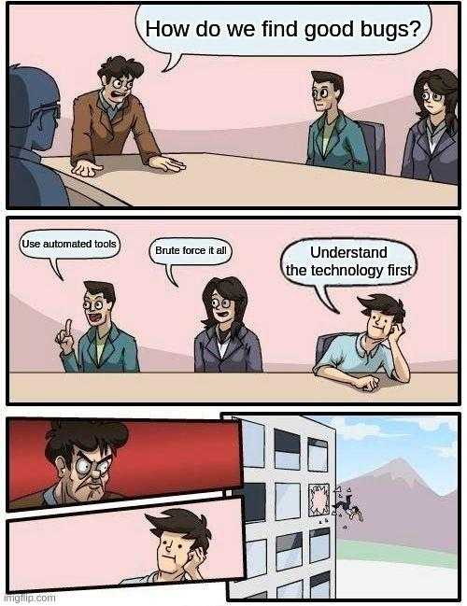
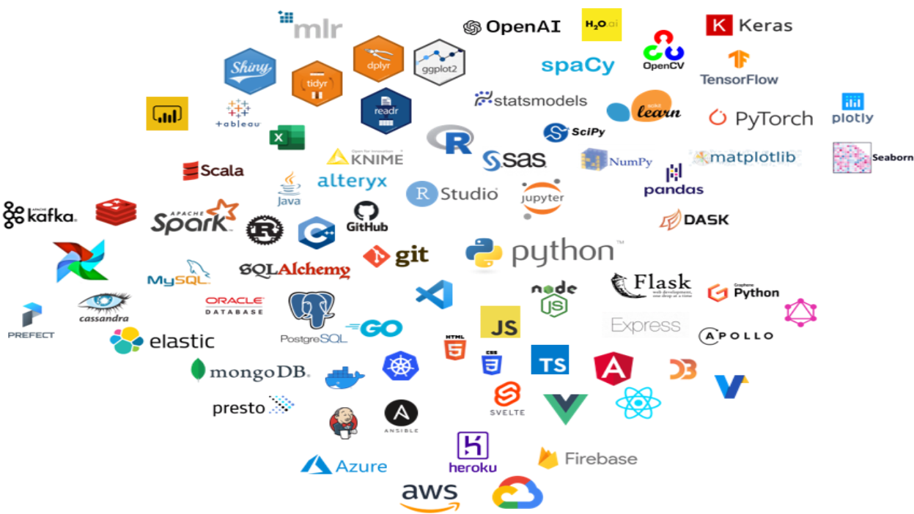
Detailed understanding of
technology stack
Notes:
When doing code review, you will have to work with lots of tech stacks
Programming languages like java, python, js, and frameworks like Django, Spring, Express.
Db like postgresql, mysql, mariadb, mongodb
This increases your horizon of knowledge

Slide 7
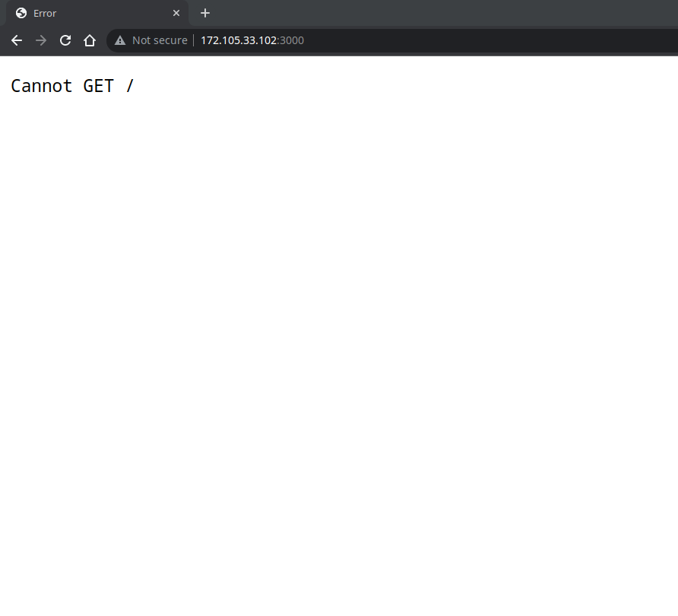
Detailed understanding of technology stack
What would you test?

Slide 8
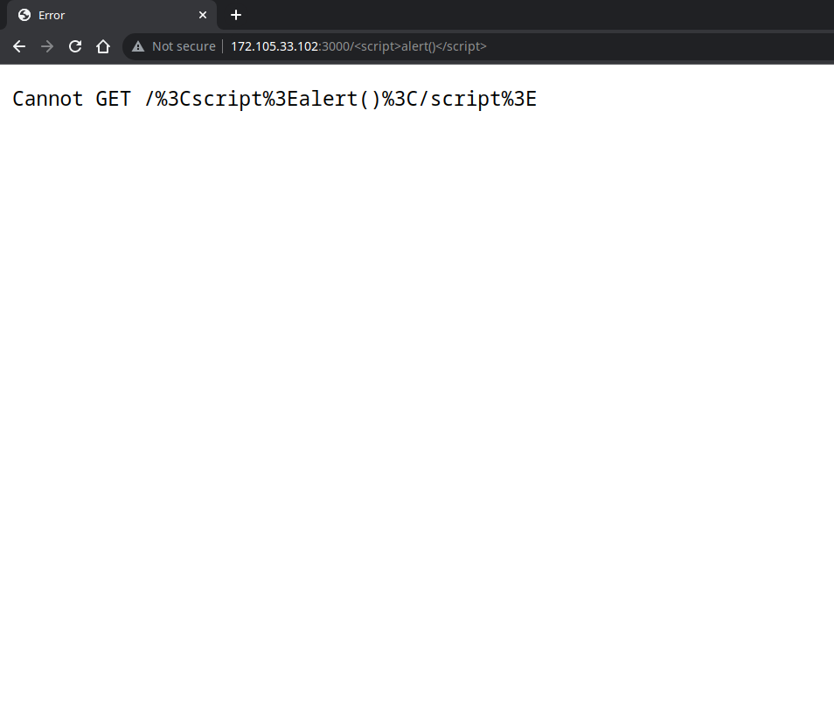
Detailed understanding of technology stack
XSS?

Slide 9
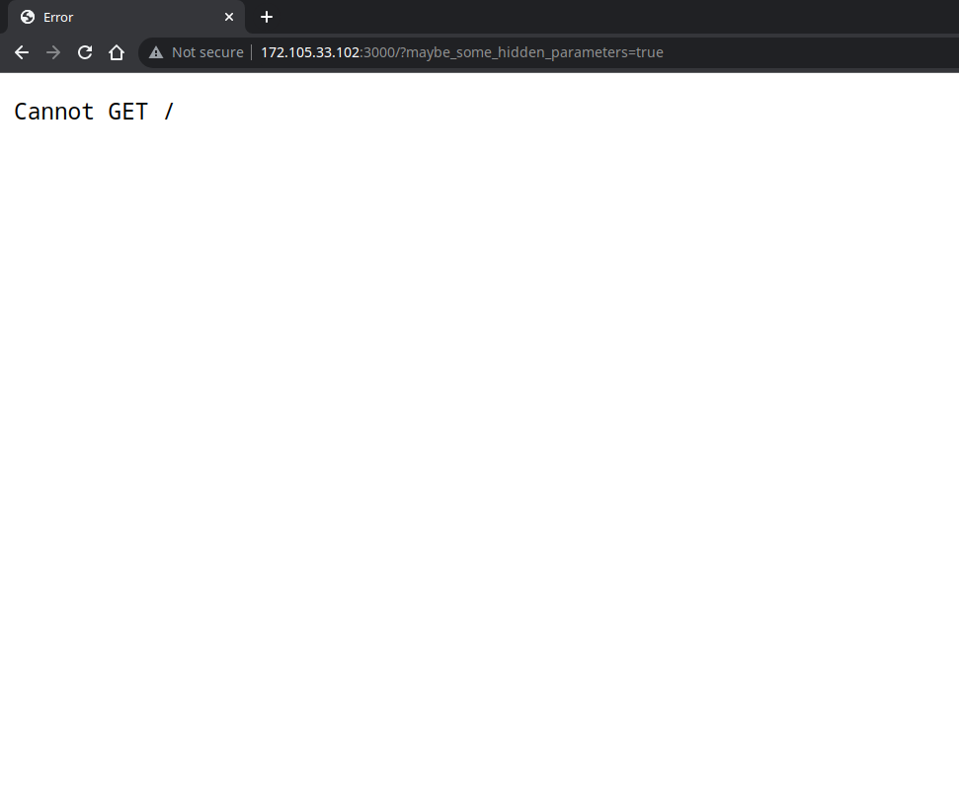
Detailed understanding of technology stack
Hidden parameters?

Slide 10
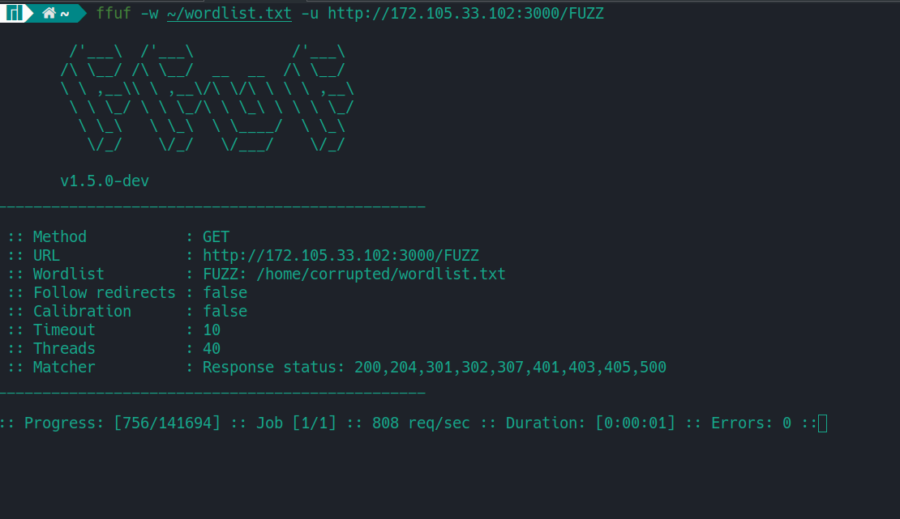
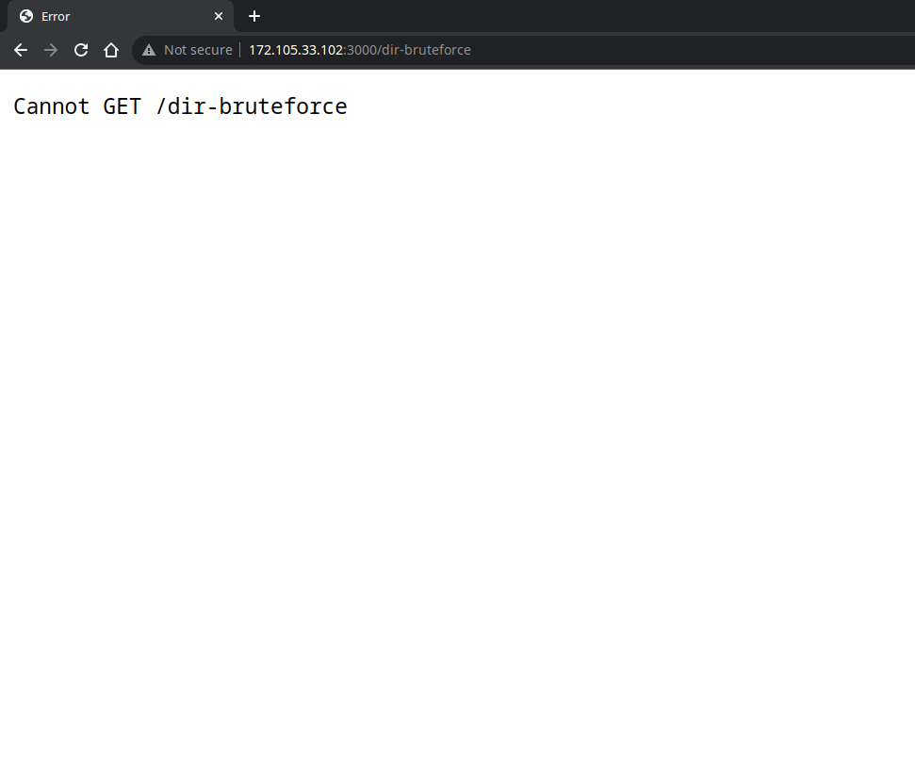
Detailed understanding of technology stack
Brute-force the GET endpoints?
Notes:
By now you might be thinking, yes this is what i’d do

Slide 11
Detailed understanding of technology stack
BUT is that all you can do?
Notes:
Brute forcing GET endpoint is correct but that’s not all you can do
If look at the error closely, you can figure out that the backend is Express js
The first 2 don’t work this is not all you can do too

Slide 12
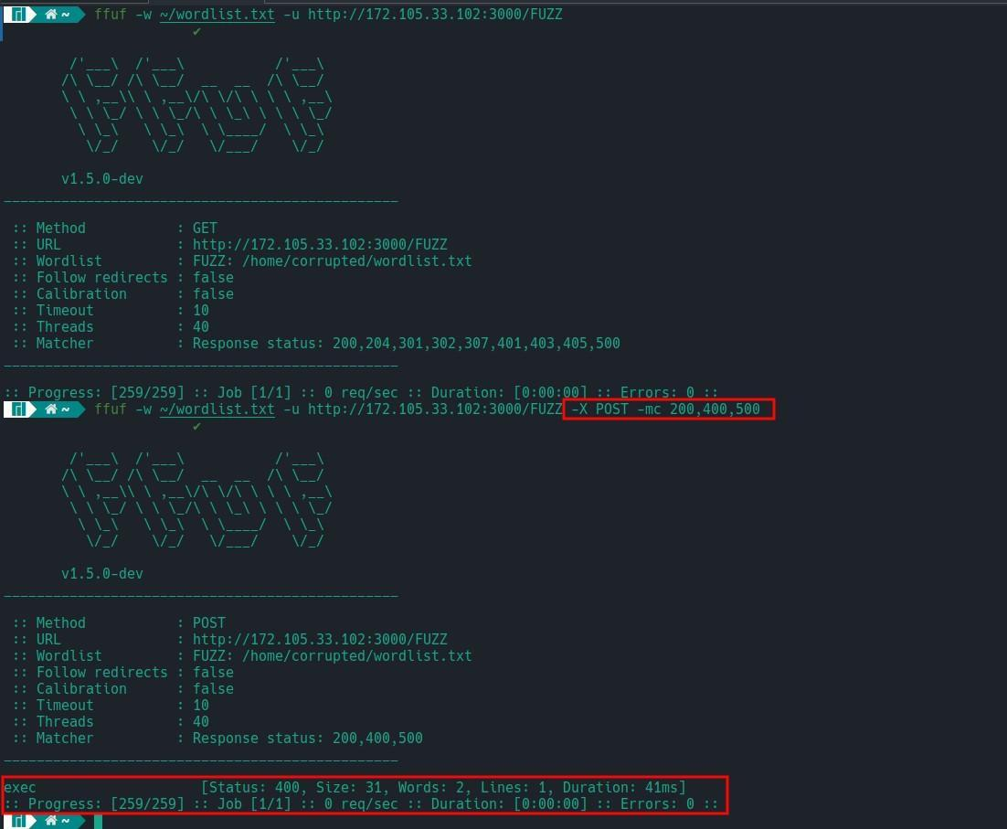
GET endpoint is
not all there is to find
Notes:
Express js routes endpoints and there’s a possibility of having POST, PUT, DELETE request without a GET endpoint at all
Above example doesn’t find any GET endpoints but finds POST /exec

Slide 13
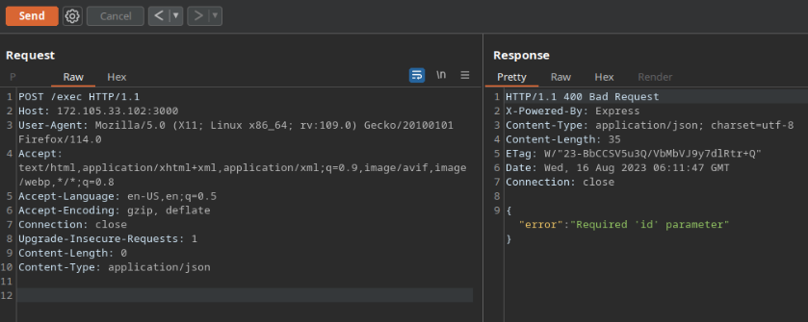
Detailed understanding of technology stack

Slide 14
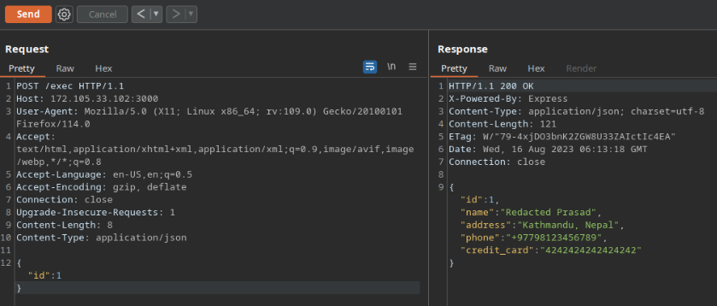
Detailed understanding of technology stack

Slide 15
Knowledge of lesser-known vuln classes
  Insecure deserialization
  Type juggling
  Cryptographic issues
  Overflow and underflow
Notes:
While these bugs can be found without code review, the probability of finding one is much higher with code review

Slide 16
To stand out from the rest of the crowd

Slide 17
Monetizing Code Review for
Bug Bounty Hunters

Slide 18
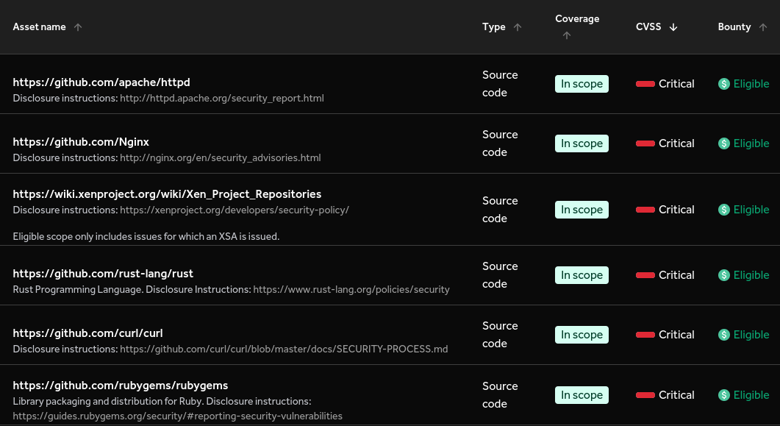
Hack on BBP with open source scope
Notes:
A lot of open source targets
Lesser competition

Slide 19
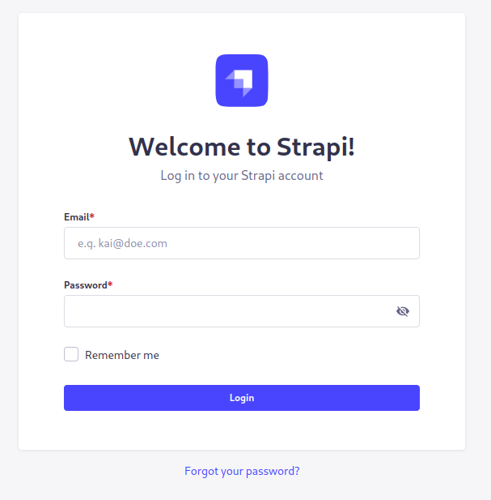
Find 0-days to hack an application
Notes:
Companies don’t build everything from scratch
Use of open-source softwares
Setup those software locally and find a 0-day on those
Example of that image

Slide 20
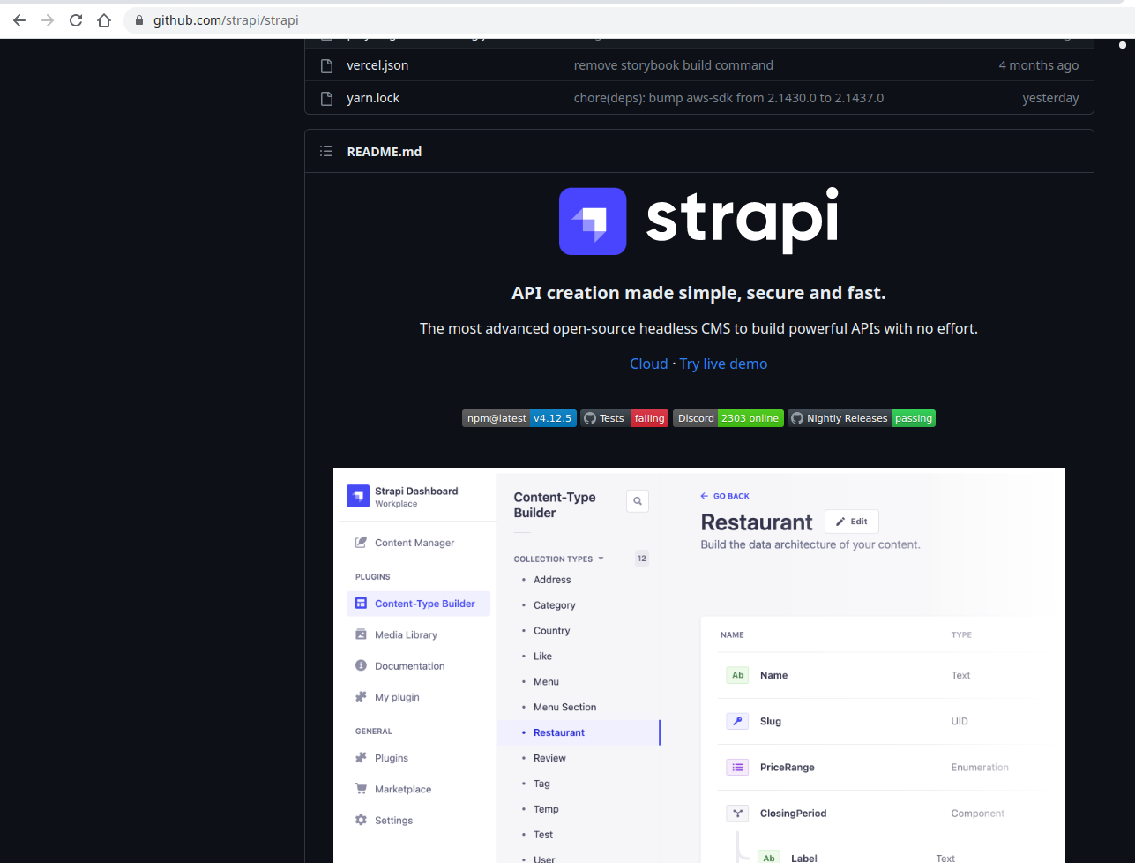
Find 0-days to hack an application
Notes:
We can see that strapi is open source
Finding a bug by code reviewing that open source project will yield result in our bb target

Slide 21
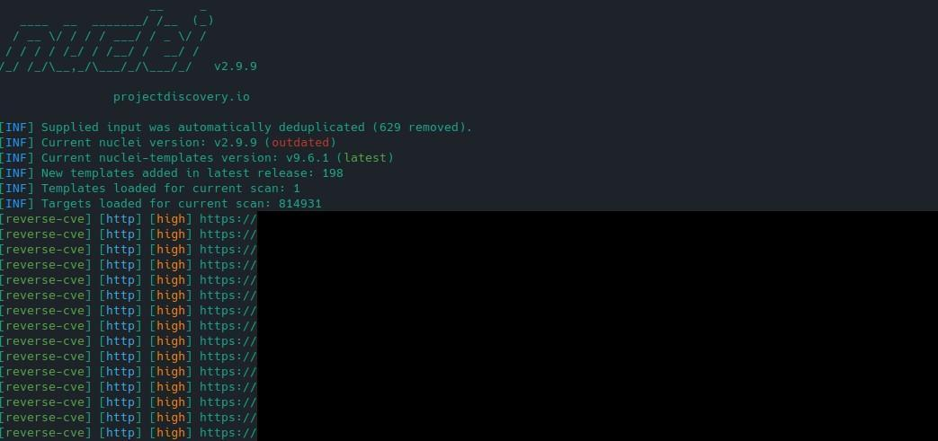
Farm 0-days on all programs
Notes:
Now farm the 0-day that you found

Slide 22
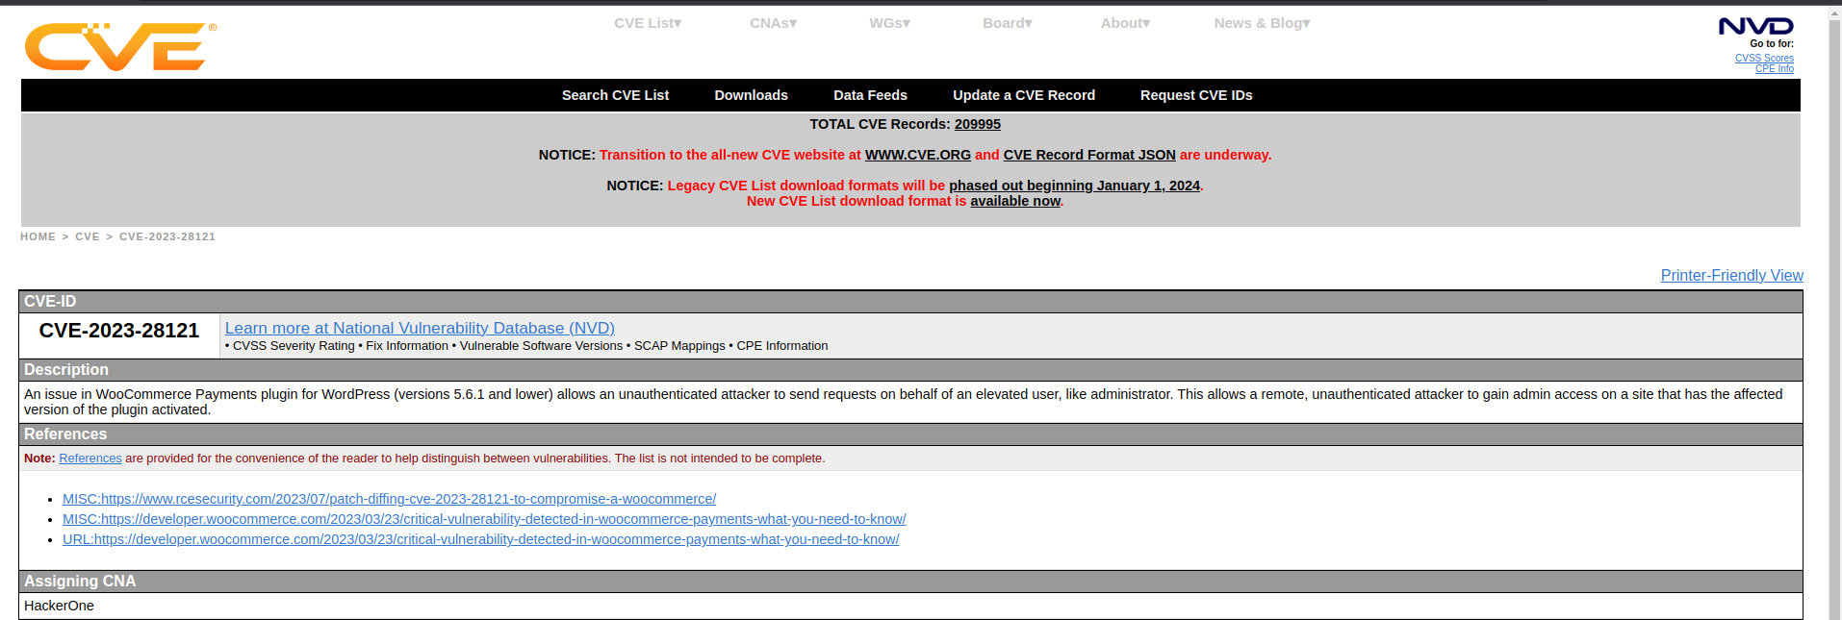
Farm CVEs and n-days
Notes:
Look for recently released CVEs in the popular software and get the poc out of it
Report vuln portals to the BBPs

Slide 23
Bonus Pathway - Vulnerability Researcher
  Find 0-days on enterprise softwares
  Ranges from low-level (Binary) to high-level (Web)
  Report 0-days to brokers like ZDI, SSD
  Participate in events like Pwn2Own

Slide 24
Prerequisites
Notes:
Now that you know what code review is, why you should learn and how you can monetize it, let’s get started into it
But before starting, there are some prerequisites

Slide 25

Learn a programming language
Notes:
Most fundamental thing is learn to code
To read code, you need to understand code
To understand code, you need to write code
Any programming language of your choice
Get the basics like variables, data types, functions, loops, OOP

Slide 26
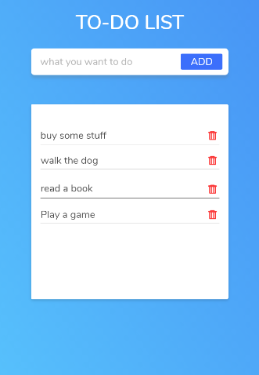
Create a web-app/API
  Use the framework of language you learned
  Use MVC design architecture
  Learn local/remote in your application
Notes:
Create a webapp to get developer’s perspective
Think like a dev to hack the dev’s mind

Slide 27
Getting Started
Notes:
Getting started by learning the vulnerable code patterns

Slide 28
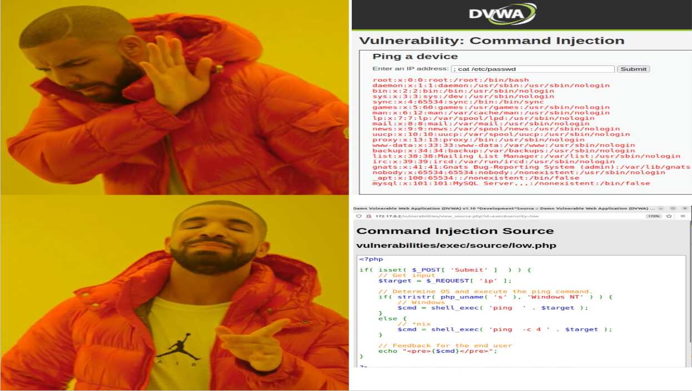
DVWA in white-box mode
Notes:
We now get back to dvwa, circle of life
Instead of firing random payloads, look at the code and try figuring out the payload from there

Slide 29
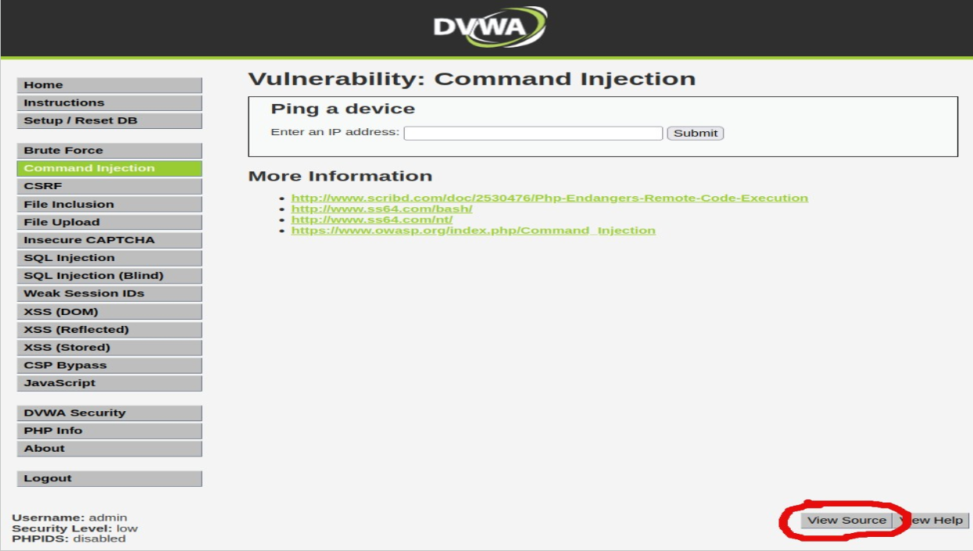
DVWA in white-box mode

Slide 30
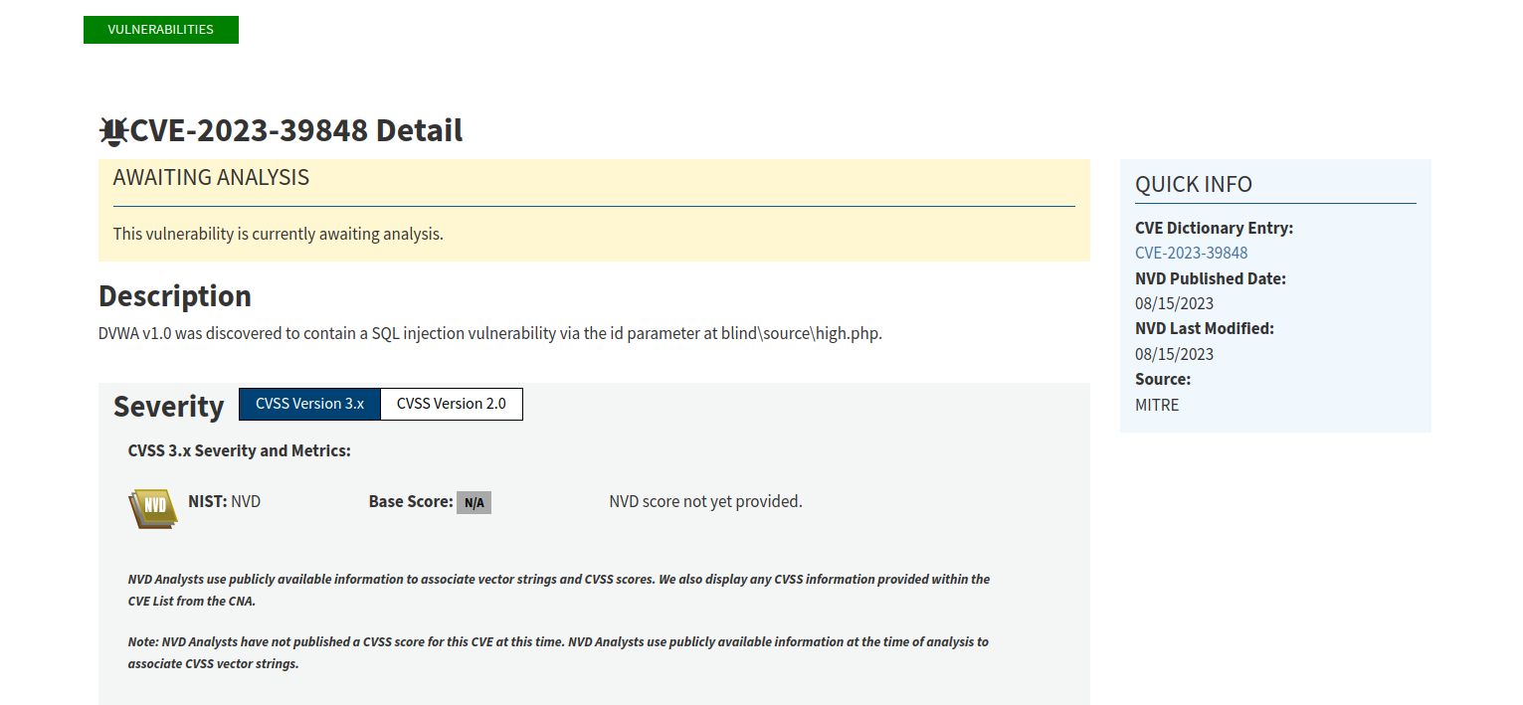
DVWA in white-box mode
Disclaimer: Please do not request a CVE for DVWA
Notes:
Someone requested a CVE for DVWA in back in August

Slide 31
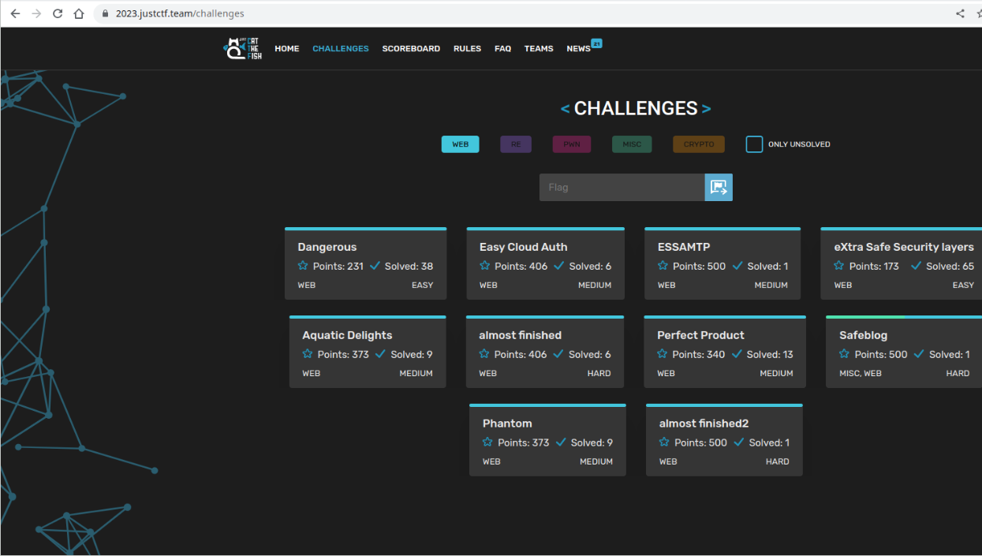
White-box CTFs
Notes:
Best way to learn in infosec is CTF
Lots of CTFs available that provide the source code

Slide 32
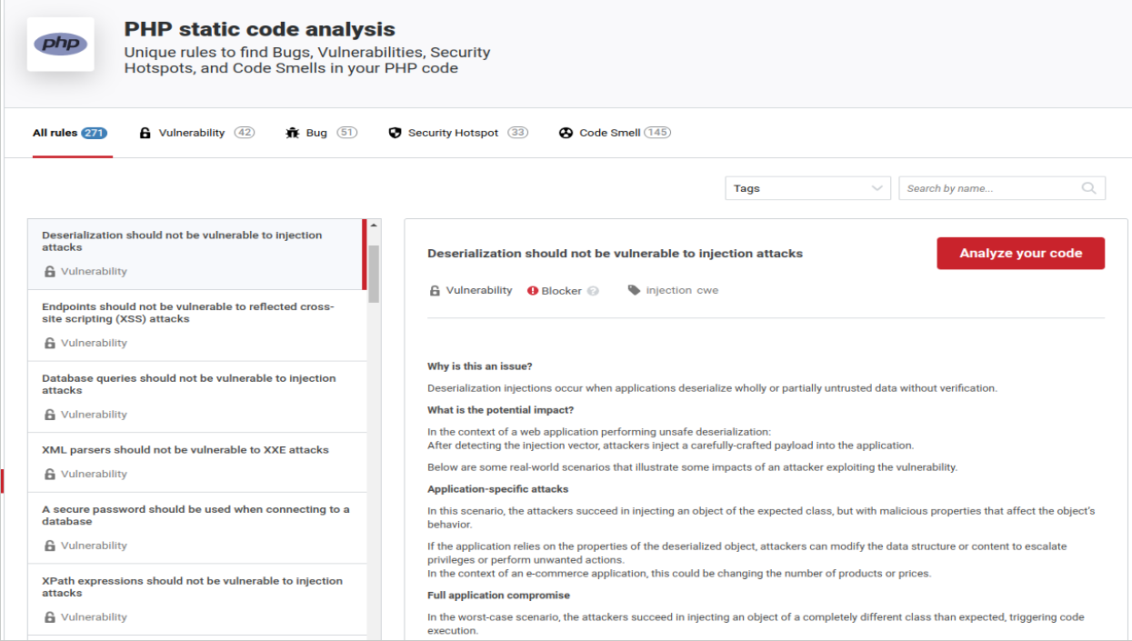
SonarSource Rules
Notes:
Lots of faulty and non-faulty code rules

Slide 33
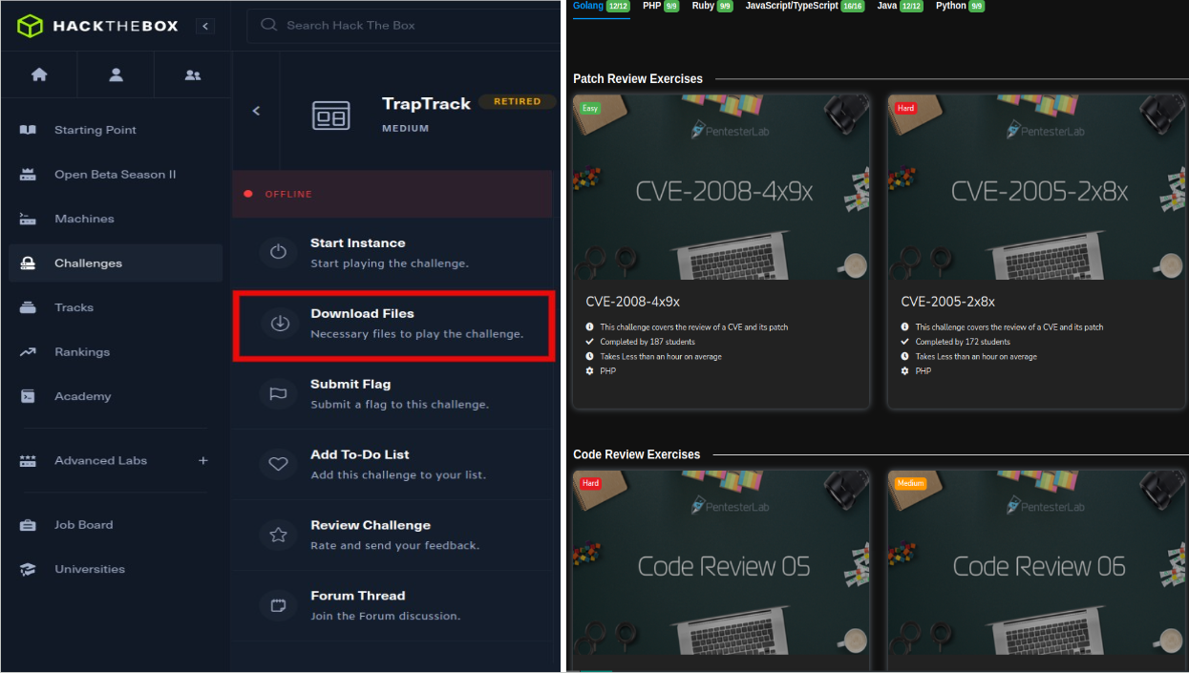
Paid Resources

Slide 34
Dive into the Real World

Slide 35
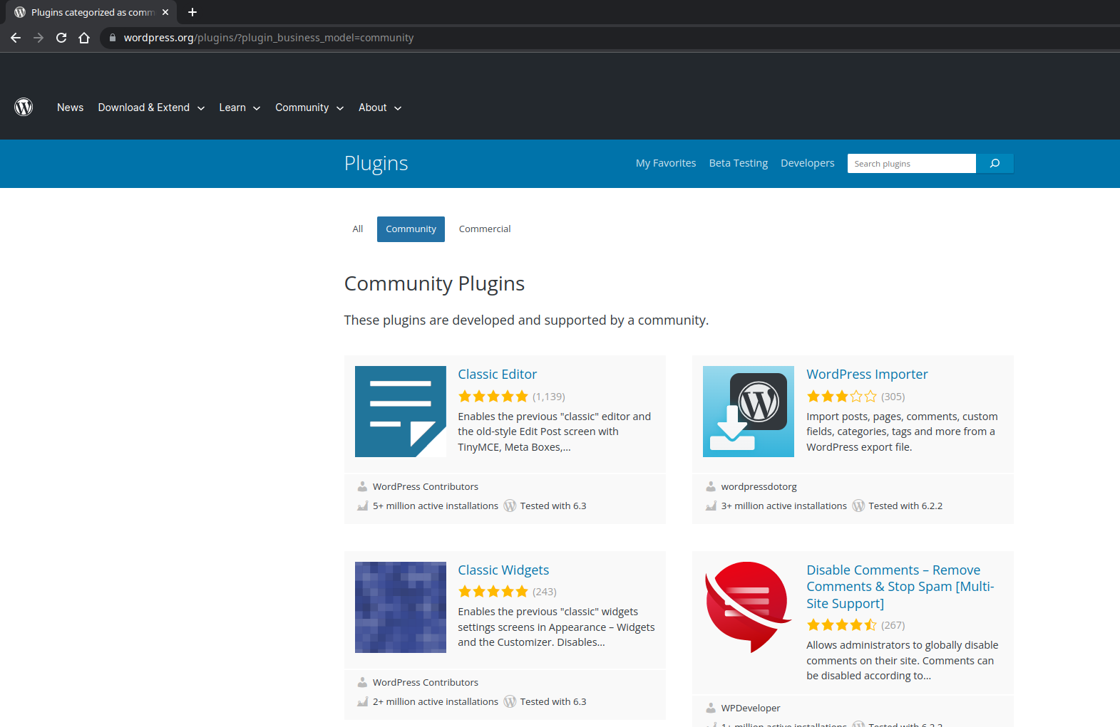
Hack WordPress Plugins
Notes:
Lots of open source wordpress plugins
Try to find bugs in less-known plugins and start from there

Slide 36
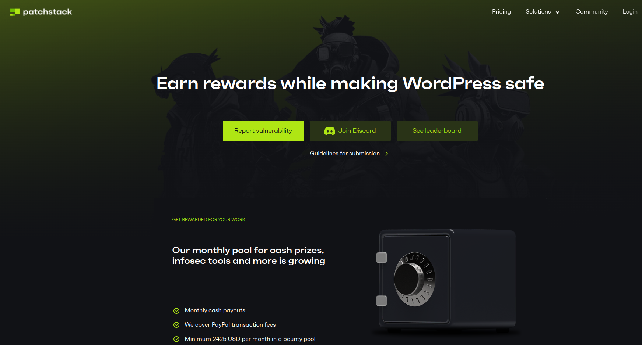
Hack WordPress Plugins
URL: patchstack.com

Slide 37
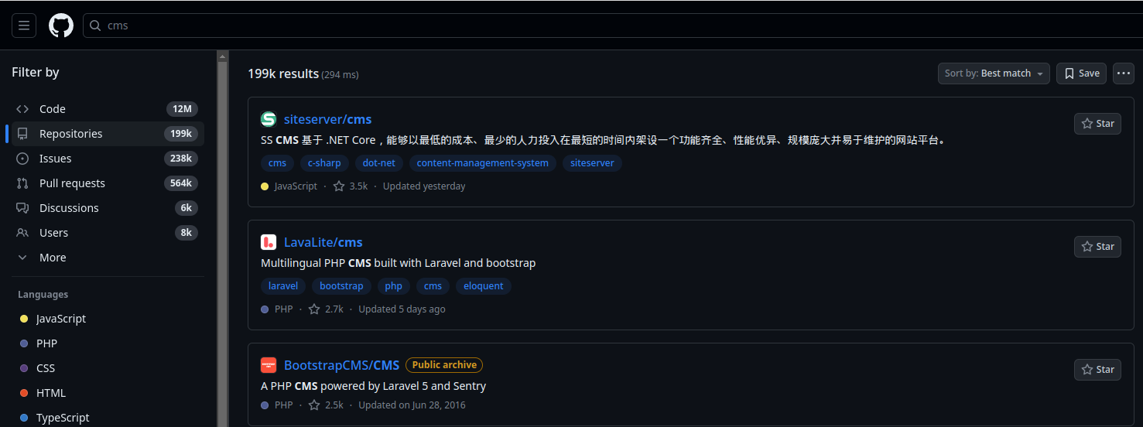
Secure Open-source
Notes:
Millions of github repo
Find bugs in less-known repo

Slide 38
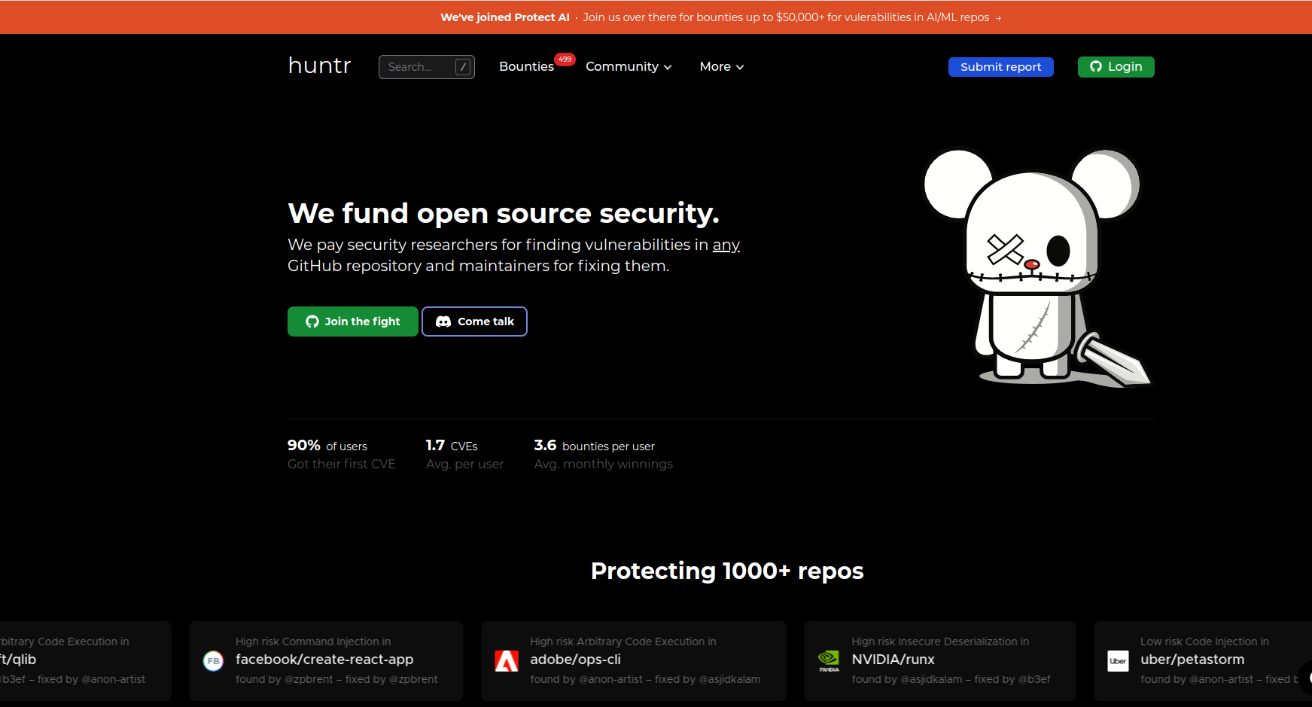
Secure Open-source
URL: huntr.dev

Slide 39
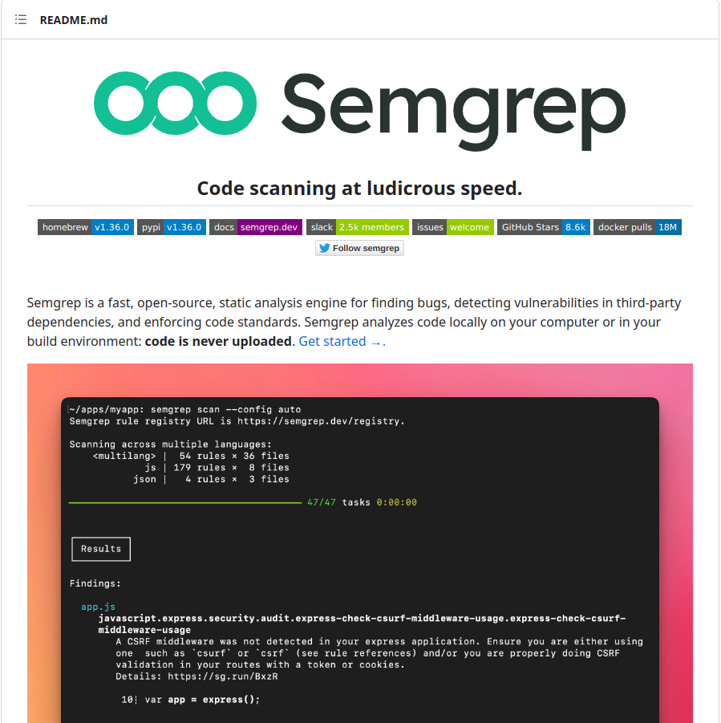

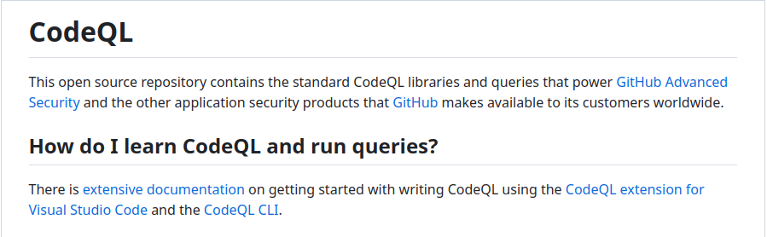
Use Automated Tools
Notes:
Semgrep - Easier and beginner-friendly
CodeQL - Harder but can perform complex tasks

Slide 40
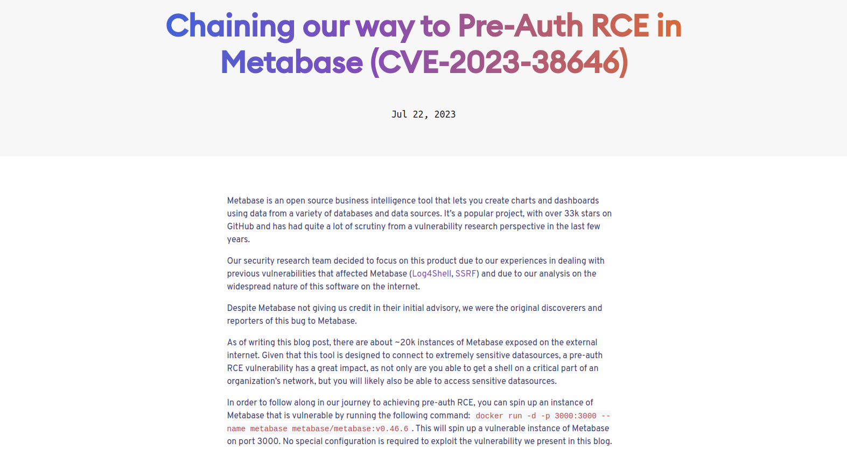
Run exploits locally
Pre-auth RCE walkthrough by Assetnote
Notes:
People disclose walkthrough for issues in open-source software
You can follow the walk-through/POC published by other people/companies to find root cause and understand it

Slide 41
Reverse the CVEs
Notes:
Best and the most fun thing to do

Slide 42
Tale of the CVE

Slide 43
[CVE-2023-26045] NodeBB Code Execution Vulnerability
  Method: Patch-diffing

Slide 44
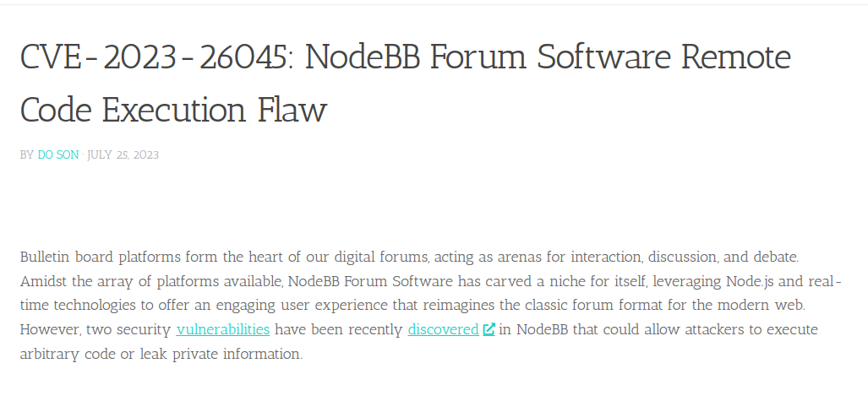
[CVE-2023-26045] NodeBB Code Execution Vulnerability

Slide 45
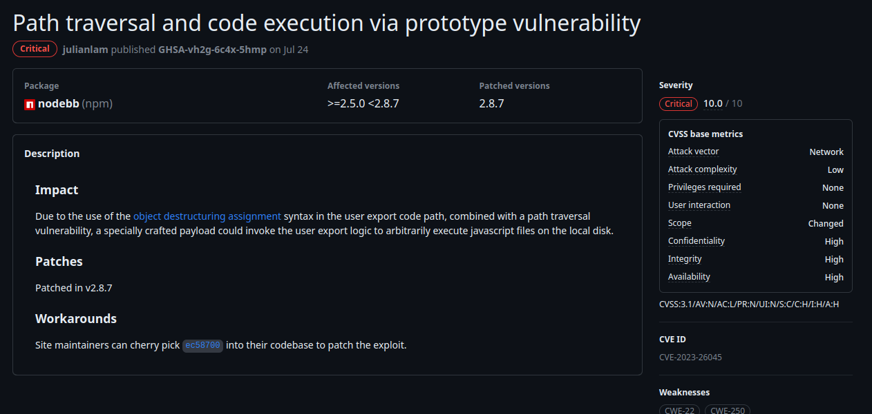
[CVE-2023-26045] NodeBB Code Execution Vulnerability
Notes:
Looking upon the github repo, a cve with the cvss score 10.0

Slide 46
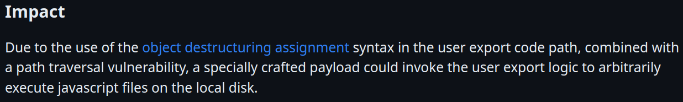
[CVE-2023-26045] NodeBB Code Execution Vulnerability
Notes:
Object destructirung assignment combined with path traversal
Local js file execute

Slide 47
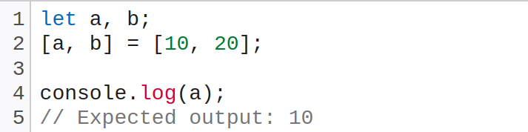
[CVE-2023-26045] NodeBB Code Execution Vulnerability
What is Object Destructuring Assignment?
A special syntax that allows us to “unpack” arrays or objects into a bunch of variables.
Notes:
Assigning variables with the elements of arrays/objects
a,b assigned with 10,20
a is 10 and b is 20

Slide 48
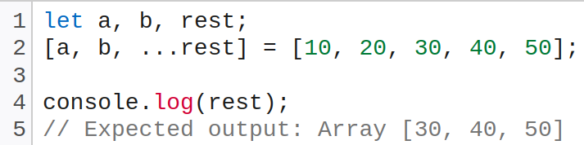
[CVE-2023-26045] NodeBB Code Execution Vulnerability
What is Object Destructuring Assignment?
A special syntax that allows us to “unpack” arrays or objects into a bunch of variables.
Notes:
If a variable has triple dot, all the remaining values will be assigned with that var
Rest has the value of 30,40, 50

Slide 49
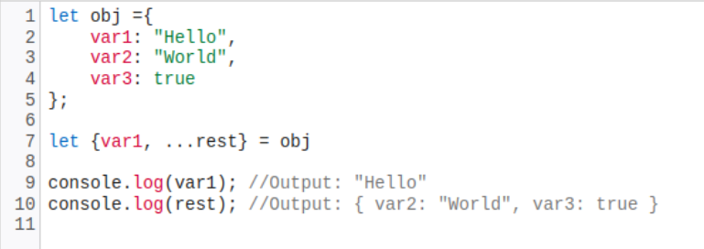
[CVE-2023-26045] NodeBB Code Execution Vulnerability
What is Object Destructuring Assignment?
A special syntax that allows us to “unpack” arrays or objects into a bunch of variables.
Notes:
Same with the functions: var1 has the value “Hello”
rest has all the remaining values
Now that we know what it is, lets look at the patch

Slide 50
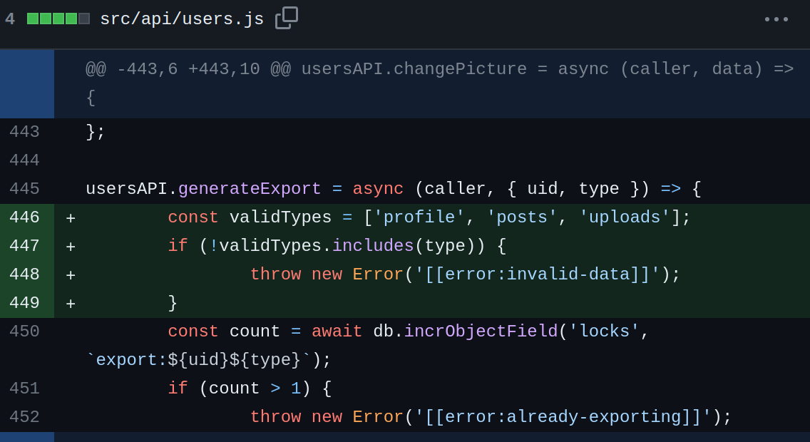
[CVE-2023-26045] NodeBB Code Execution Vulnerability
Notes:
Type variable is being checked

Slide 51
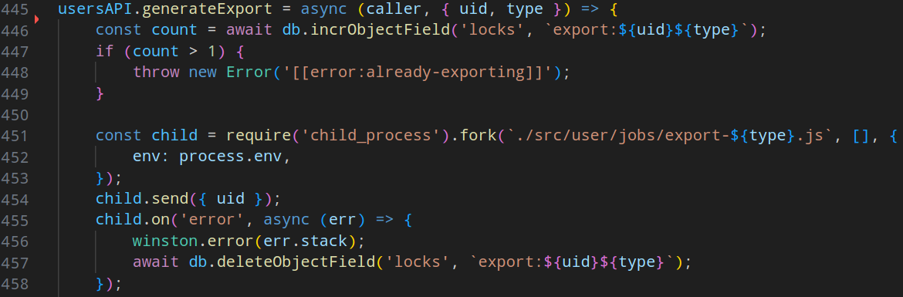
[CVE-2023-26045] NodeBB Code Execution Vulnerability
Notes:
At line 451, child_process method is called that is basically running the js file that the value type variable has

Slide 52
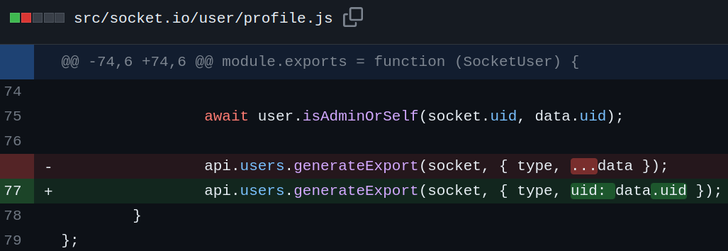
[CVE-2023-26045] NodeBB Code Execution Vulnerability
Notes:
If we look at the patch, tripe dot has been removed from data var
If the data var is in our control, we can even overwrite the type variable because data is taking all the values
Data is what the user sends in the websocket request

Slide 53
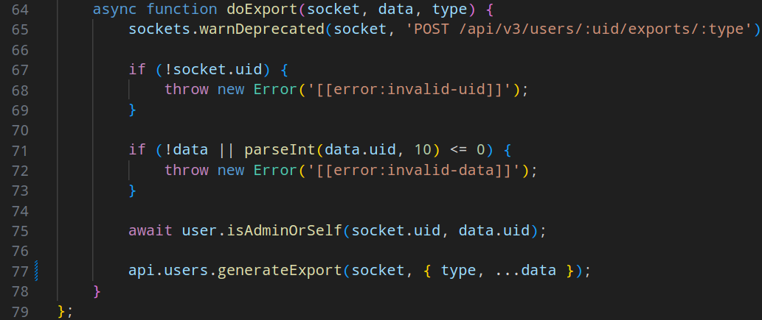
[CVE-2023-26045] NodeBB Code Execution Vulnerability
Notes:
The full vuln function looks like this. Here, all the data from “data” var is passed to generateExport function.

Slide 54

[CVE-2023-26045] NodeBB Code Execution Vulnerability

Slide 55
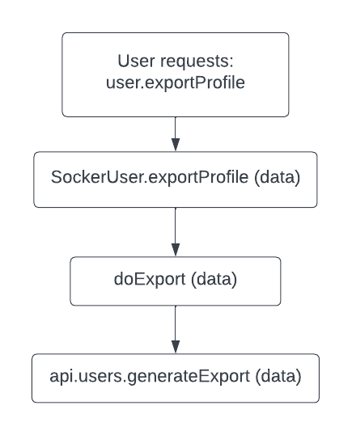
[CVE-2023-26045] NodeBB Code Execution Vulnerability

Slide 56
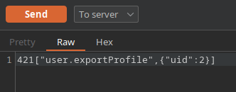
[CVE-2023-26045] NodeBB Code Execution Vulnerability
A normal websocket request to execute the vulnerable code path.

Slide 57
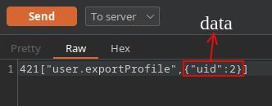
[CVE-2023-26045] NodeBB Code Execution Vulnerability

Slide 58
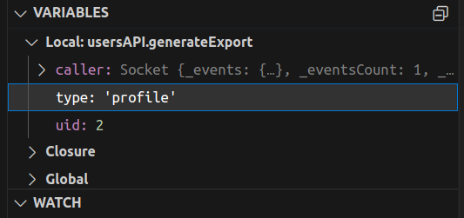
[CVE-2023-26045] NodeBB Code Execution Vulnerability
Notes:
Hit in the breakpoint and looking at the variables, the type is ‘profile’

Slide 59
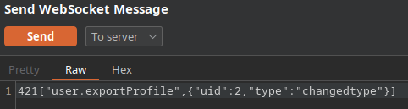
[CVE-2023-26045] NodeBB Code Execution Vulnerability
Notes:
Now if we send a request with our type var

Slide 60
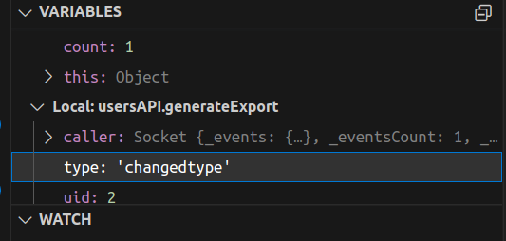
[CVE-2023-26045] NodeBB Code Execution Vulnerability
Notes:
The type will be changed

Slide 61
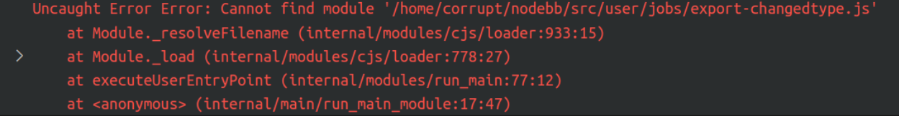
[CVE-2023-26045] NodeBB Code Execution Vulnerability

Slide 62

[CVE-2023-26045] NodeBB Code Execution Vulnerability

Slide 63
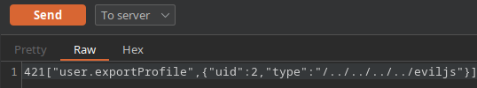
[CVE-2023-26045] NodeBB Code Execution Vulnerability

Slide 64
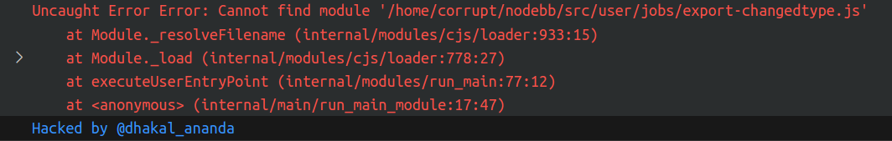
[CVE-2023-26045] NodeBB Code Execution Vulnerability
Notes:
Got a log in the console proving that the js file was executed

Slide 65
[CVE-2023-26045] NodeBB Code Execution Vulnerability
But how do I upload the js file?
Using the features that allow files/attachments sharing
Notes:
If shared server, uploading the file in another app can also lead to code execution through this path

Slide 66
Reverse the CVEs:
Learn & Earn
Notes:
Example of how it works, lots of cves to reverse and learn from them
Even though couldn’t find any BBP running the vulnerable version,
I learned about object destructing assignment by reversing this CVE

Slide 67
Any questions?

Slide 68
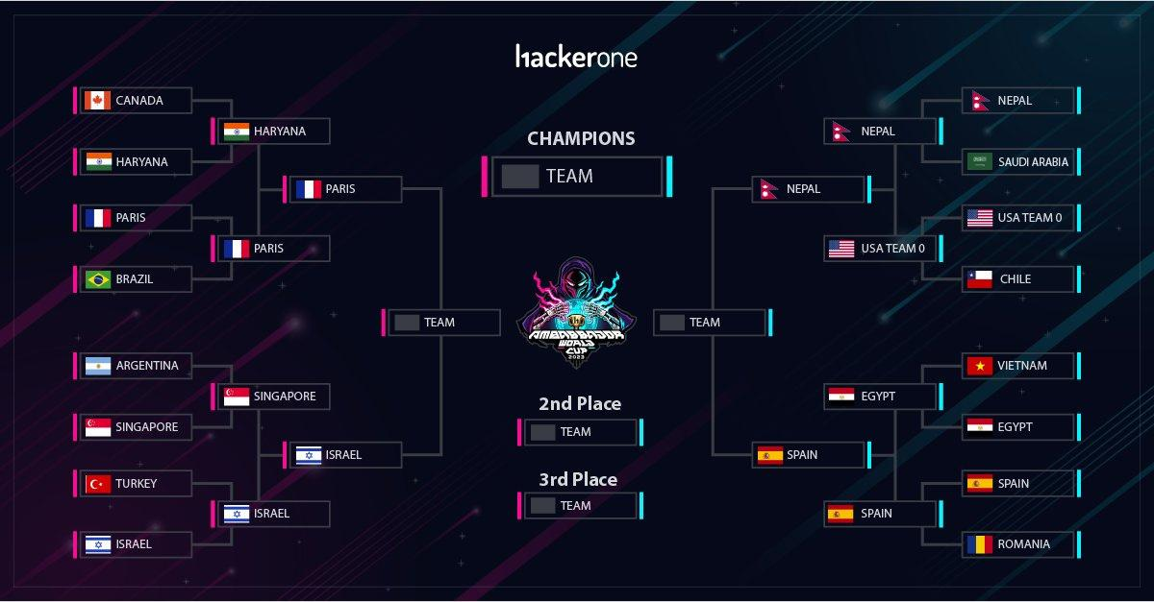

Slide 69
Thank you!

