Slide 1
Supply-Chain Attacks: What, Why, and How?
Danish Tariq
Hassan Khan Yusufzai

Slide 2
whoami
Danish Tariq
Learner.
Security Engineer.
Former top-rated professional at Upwork.
Featured in "The Register" for an initial workaround for the NPM dependency attacks.
Recent CVEs include - CVE-2022-2848 & CVE-2022-25523.
Was a moderator @ OWASP 2022 Global AppSec APAC.
Helped and got acknowledged by companies like include Microsoft, Apple, Nokia, Blackberry, and Adobe to name a few.
Certified Ethical Hacker (Practical) & Certified Vulnerability Assessor (CVA)
HITB Trainer
Spoke @ BlackHat.

Slide 3
Disclaimer
This talk/presentation is for educational purposes and is intended to spread awareness in a way that you could be vigilant. Nothing here is presented to be used in any malicious/illegal/unethical way.

Slide 4
Supply Chain
Traditionally and generally supply chain means the involvement or a network of suppliers, raw materials, and manufacturer(s) etc. to produce a specific final product and then supply to the final consumer. It involves:-
People
Entities
Information
Resources
Activities

Slide 5
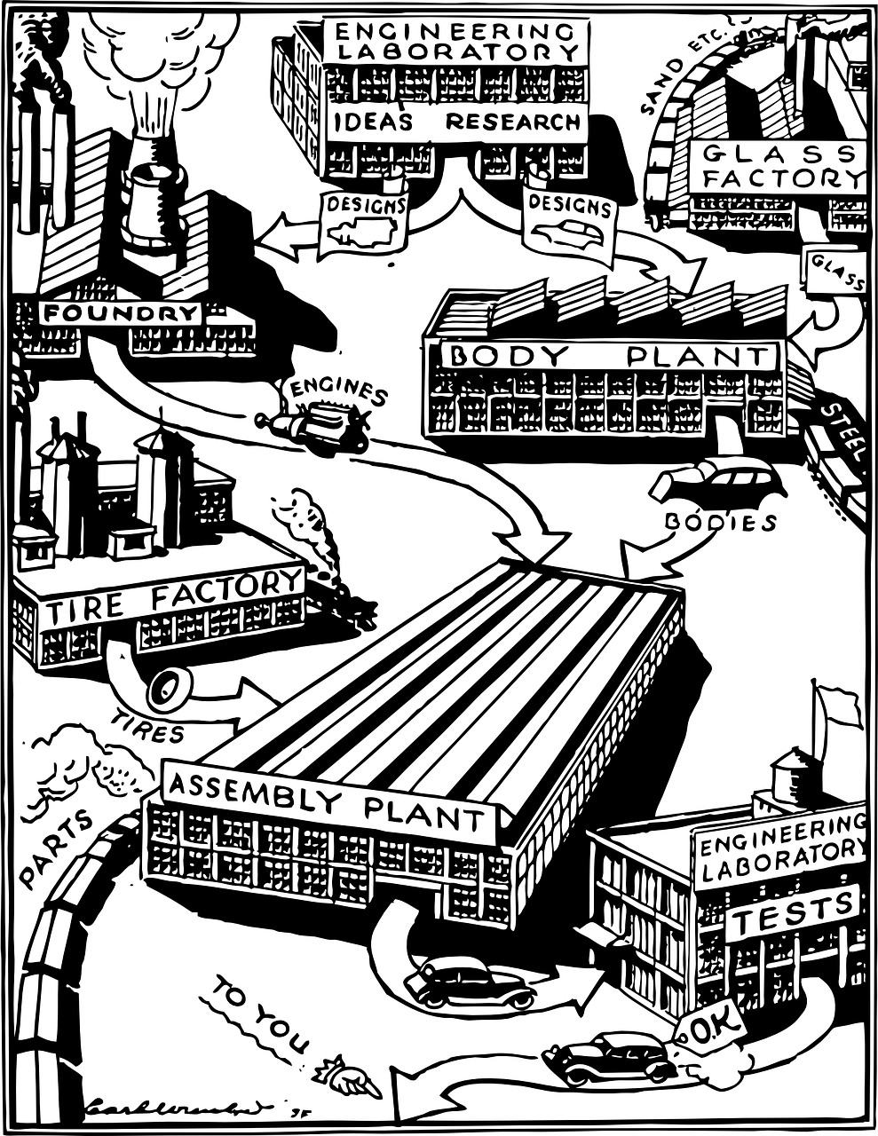

Slide 6
Software Supply Chain
Software supply chain is anything that goes into the codebase until it made it to production whether we talk about the dependencies, binaries, or other components.
Source
Build
Package
Developer
User
Dependencies

Slide 7
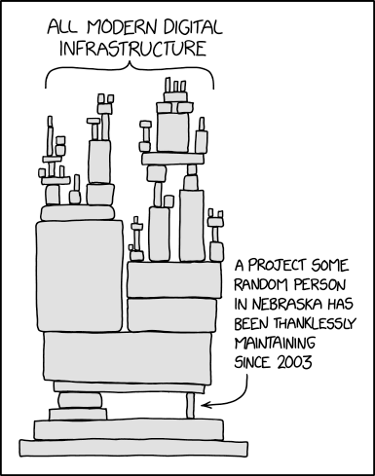
A chain is only as strong as its weakest link
Image courtesy of xkcd.com

Slide 8
Supply chain attacks
Source
Build
Package
Developer
User
Dependencies
Security issues we are going to discuss today and highlight few

Slide 9
Examples
Vulnerabilities - Simply a vulnerability in a dependency is mostly a vulnerability in your codebase i.e. Log4Shell
TypoSquatting - Mimicking the name of a trustworthy package to fool developers to trust a malicious one. i.e. rust_decimal -> rustdecimal. i.e. Pykafka -> Pymafka
RepoJacking - Attacker could claim Repo. username when an actual person changes the name

Slide 10
Examples
Account takeover - Taking over an email address or account of legit maintainer of a package to push out malicious packages.
Dependency confusion -
A security researcher was able to breach Microsoft, Uber, Apple, and Tesla. The researcher, Alex Birsan, took advantage of dependencies that applications use to provide services to end-users. Through these dependencies, Birsan was able to transmit counterfeit yet harmless data packets to high-profile users. -Fortinet.

Slide 11
The attack on ASUS, according to Symantec researchers, took advantage of an update feature and impacted as many as 500,000 systems. In the attack, an automatic update was used to introduce malware to users’ systems. - Fortinet
These companies were affected by Log4Shell in one way or another - Apple, Tencent, Twitter, Baidu, Steam, Minecraft, Cloudflare, Amazon, Tesla, Palo Alto Networks, IBM, Pulse Secure, Ghidra, ElasticSearch, Apache, Google, Webex, LinkedIn, Cisco and VMware.

Slide 12
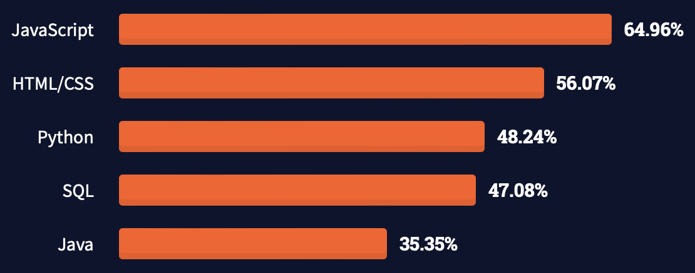
npm (Node Package Manager)
npm is the world's largest Software Registry
JavaScript completes its ninth year in a row as the most commonly used programming language. ( Stack Overflow’s 2021 Developer Survey) & JavaScript currently stands as the most commonly-used language in the world (64.96%)

Slide 13
Example of a package

Slide 14
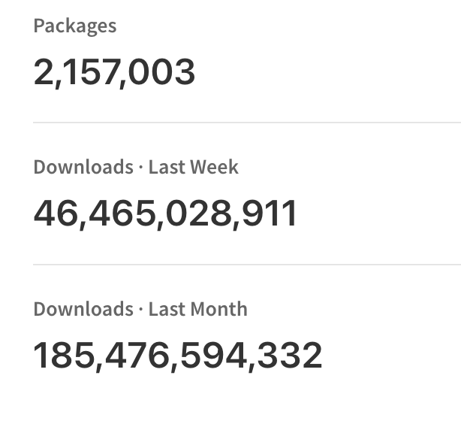
npm (Node Package Manager)
npm packages are used by developers on a regular basis.
There are maintainer(s) of these packages who could push out updates.
Credits: Npmjs.com (31 Oct 2022)

Slide 15
Notes:
ß

Slide 16
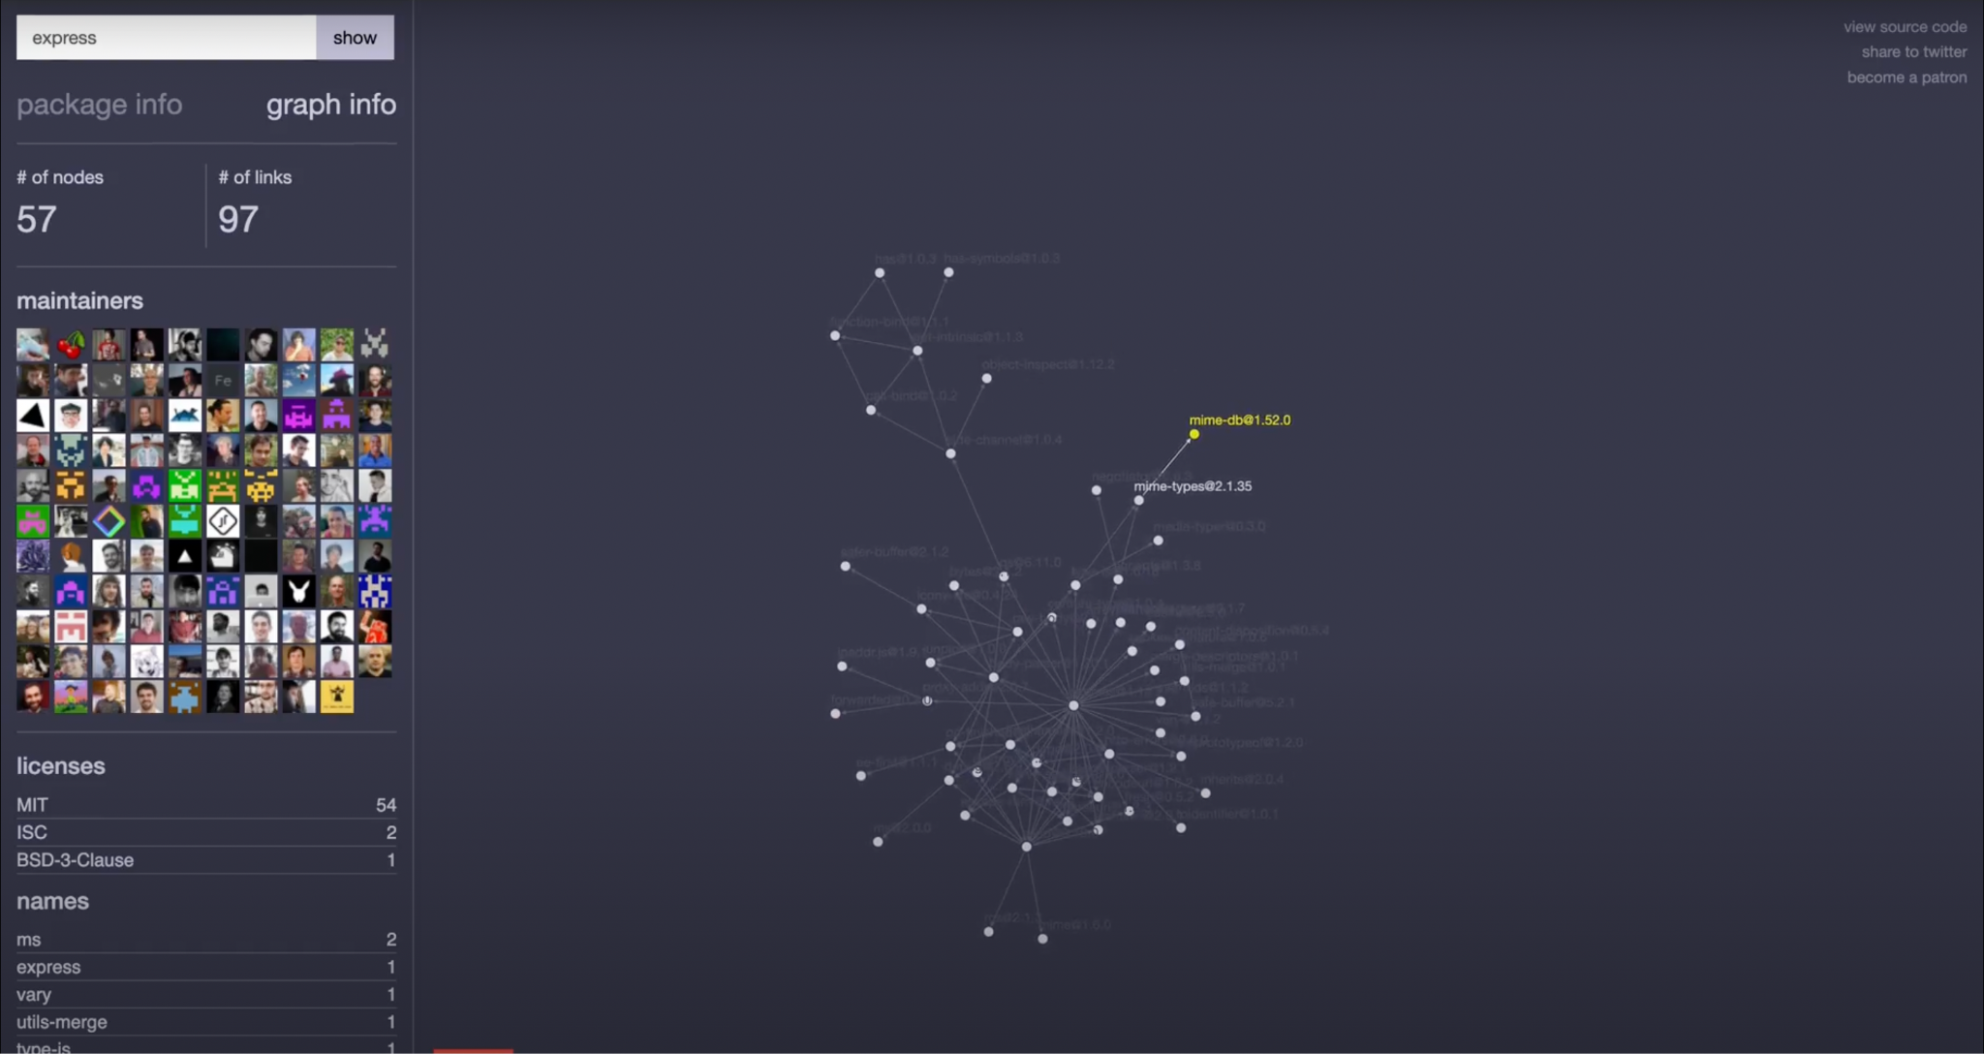

Slide 17
npm (Node Package Manager)
What if the accounts of those maintainers get hacked?
There are two common possibilities that we could consider - What if their email addresses are takeoverable? - What if their passwords are leaked in some breach?

Slide 18
Maintainer email address takeover.
Package is maintained by maintainer(s).
Those maintainers could make changes, push out new updates.
Maintainer account is linked with an email address (obviously).
What if the domain of that email address is expired ? maintainer@expired.com

Slide 19
Maintainer email address takeover.
If the domain is expired of an email address.
An attacker could potentially takeover the domain by buying it again and then create a same email address.
Now an attacker could takeover an account of that maintainer !
What does that mean ? or What’s the significance ?

Slide 20
Significance of maintainer email - Recently.
Credits: The Register.

Slide 21
36,000 dependant projects
Example of a package on which 36K+ projects depends.
Domain
Package
Software Registry Account
Maintainer(s)

Slide 22
36,000 dependant projects
Expired Domain
Package
Software Registry Account
Email
Maintainer(s)

Slide 23
36,000 dependant projects
Expired Domain
Package
Software Registry Account
Email
Attacker

Slide 24
Process - Attacker’s perspective
Attacker looks for the maintainer(s) of a target package.
Attacker takes out a maintainer(s) email address(es).
He/she would see whois data of the domain(s) of the email address(es).
If the domain is expired he would buy that domain.
Create and email inbox same to that of victim.
Forgot password on software registry.
Create malicious updates and so on.

Slide 25
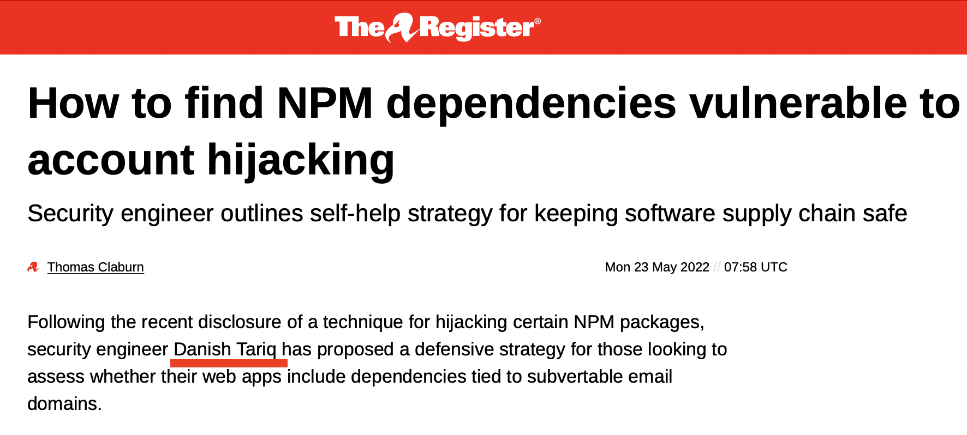
Defensive strategy for projects or companies
npm packages
Credits: The Register.

Slide 26
Defensive strategy for projects or companies
Manually
List down all the packages that your company is using or use the pre-organized lists within your codebase.
Query each package for the below command for the maintainer(s) email address(es). (this needs npm installation in CLI).

Slide 27
Defensive strategy for projects or companies
Manually
Now you would have output containing email addresses. Copy that output.
Separate the email addresses and separate the list of all the domains.
Run Whois on all the domains and you would find out if any domain is expired.
Third-party tools like email identifier. from the bulk data and email validators could be used

Slide 28
Defensive strategy for projects or companies
Automated
Mostly, hundreds of packages are used by a single org.
Preferable to repeat this on regular basis.
Cron-job could be implemented with this to keep your codebase secure from this attack vector too!
These were the motivations behind sharing this automated script.
Notes:
NOTES for Hassan Most of the organizations use hundreds of the packages or dependencies so it is not feasible to test those manually.
Moreover, it is good to repeat this process frequently and in regular intervals for a better security posture.
This provided a motivation to automate this process and open source the tools for other organizations!
Cron-job could be implemented with this to keep your codebase secure from this attack vector too!

Slide 29
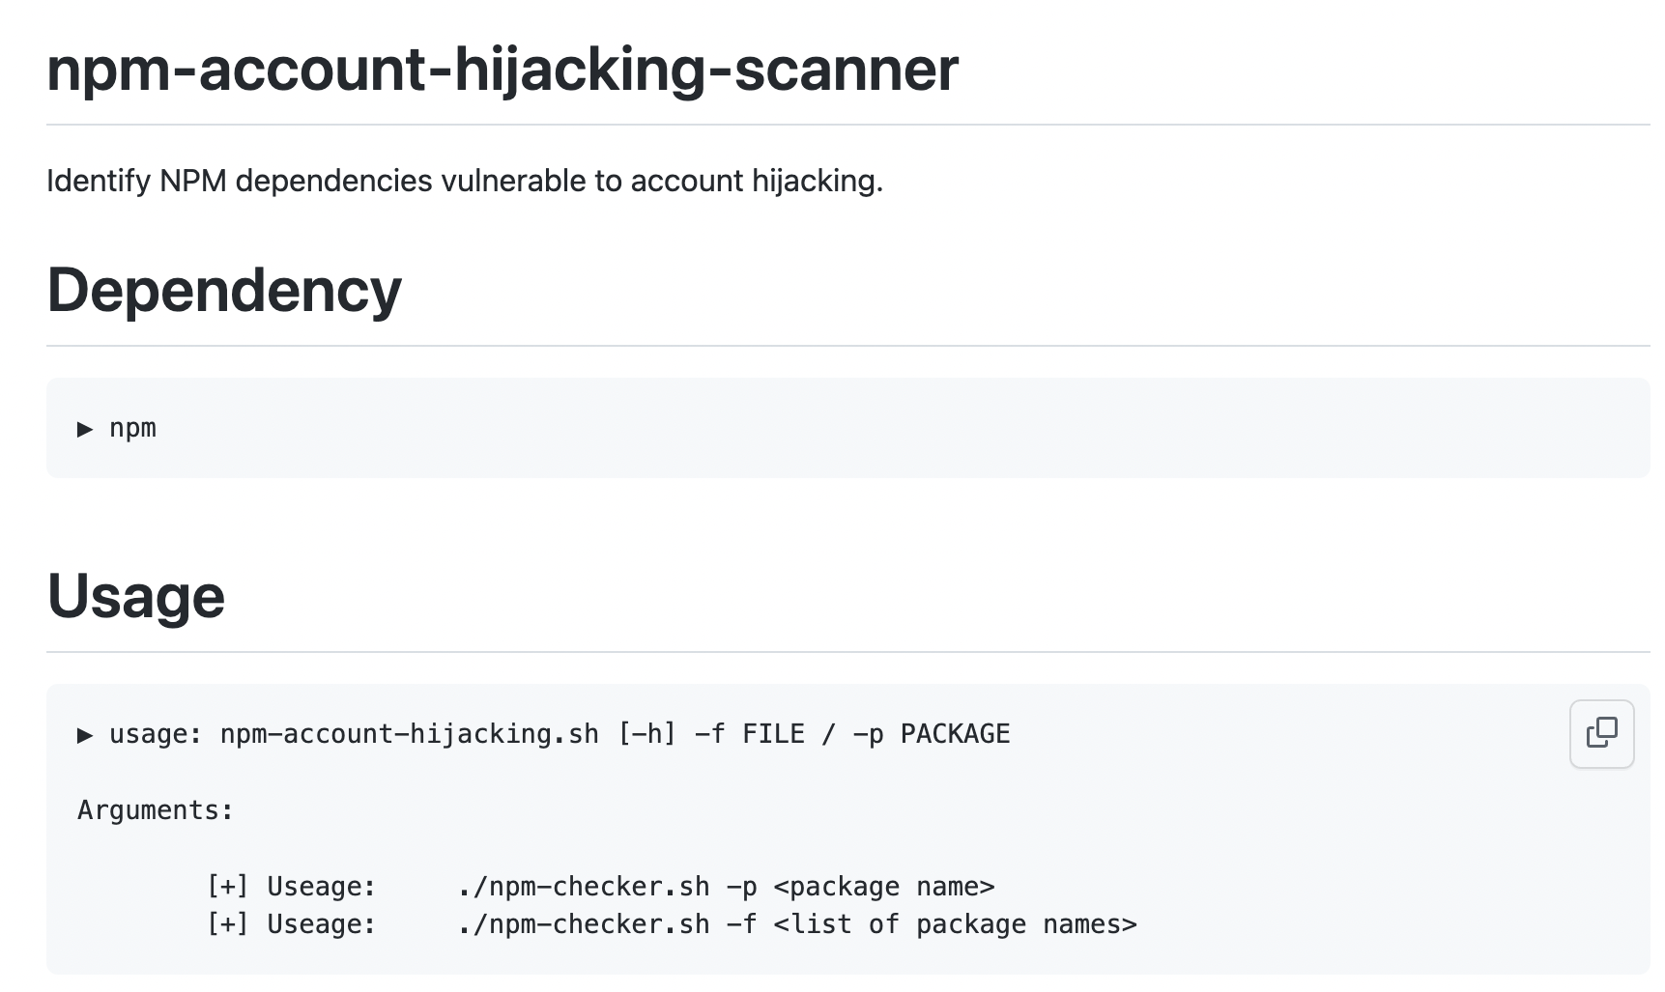
Defensive strategy for projects or companies
Automated
Wrote a mini tool which could identify the takeoverable packages in your codebase for you.

Slide 30
Defensive strategy for projects or companies
Automated - Demo
Install it. - could be accessible @ https://github.com/Splint3r7/npm-account-hijacking-scanner
Test out a single package with the following command.
bash npm-account-hijacking.sh -p package_name_here

Slide 31
Defensive strategy for projects or companies
Automated - Demo
Whole list of your packages could be scanned with the below command. Compile a list in your file “packages.txt”.
bash npm-account-hijacking.sh -f packages.txt

Slide 32
Research – world-wide-how
In this research, it was a motivation to found out what’s the security posture of packages in general. (against the account takeover possibilities).
World-Wide-Scan
Packages were collected from the publicly available sources.
Crafted and modified scripts + our high RAM servers and budget were utilized to conduct this research.

Slide 33
$ /usr/local/bin/whoami
Hassan Khan Yusufzai
Senior Security Engineer
Focused Researcher
Did OSCP for fun
Recent CVEs include - CVE-2022-1556 & CVE-2022-1391.
Helped and got acknowledged by companies like include Google, Microsoft, Dell, Intel, Magento and other 200+
Author of Rails Security Guide
HITB Trainer
Spoke @ BlackHat.
Love to mass scan the for fun ＼(^o^) /
Traveling the world

Slide 34
Research - npm packages (domains)
Step 1: Firstly, packages were collected from the internet
2.1+ million packages (2,118,539 to be precise) packages were identified while conducting this research.
Total packages on the date mentioned were 2.1+ million (2,157,003) on Npmjs.org
Collected packages
2,118,539
Credits: Npmjs.com (31 Oct 2022)

Slide 35
Research - npm packages (domains)
Step 2: Email addresses of maintainers of ALL the packages were identified.
Command ~ npm view package_name_here maintainers.email was ran 2,118,539 (2.1+ million) times in parallel.
Obviously this was achievable by a huge processing power and a little bit of effective scripting.
6,789,211 (6.7+ million) email addresses were extracted !

Slide 36
Extract email addresses
Collected packages
6,789,211 (6.7+ million)

Slide 37
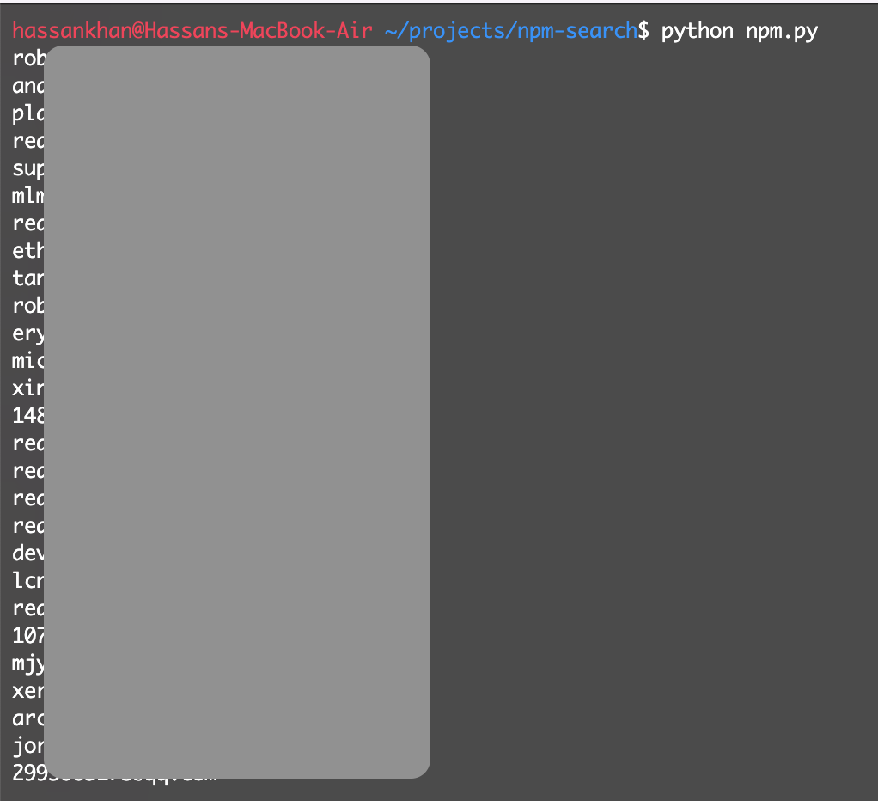
Research - npm packages (domains)
Alternative of Step 2:
NPM Public API could also be utilized for email extraction.
https://gist.github.com/Splint3r7/69e73ac50b809b8618d41729d8bf03e8

Slide 38
Research - npm packages (domains)
Step 3: Email addresses were sorted to remove the email addresses which were repeating in the list. Example:- if x@y.com was repeating in a list, it was removed in the repetitive rows.
603,887 unique email addresses were separated or fetched out from this sorting step !

Slide 39
Collected packages
Extract email addresses
Bin
Unique email?
No
Yes
Unique emails
603,887

Slide 40
Research - npm packages (domains)
Step 4: Simply, domains were separated from the email list which was obtained from the recent step.
Now we have 603,887 domains.
Step 5: Domains were sorted out to remove the repeating domains as done for email addresses in Step 3.
Now we have 132,632 domains.

Slide 41
Collected packages
Extract email addresses
Bin
No
Unique email?
No
Yes
Unique domain?
Unique emails
603,887
Yes
Extract domains
Unique domains
132,632

Slide 42
Research - npm packages (domains)
Step 6: In this step it was identified that how many domains and which domains out of 132,632 domains are expired.
whois lookup was done for these domains.
Problem we faced: There is a rate limitation problem in this so APIs were used and parallel scenario was created.
Expiration dates were fetched and any date before the date of this step were considered expired.
Number of expired domains was - 675 domains.
Shoutout @ Yevgen Goncharuk

Slide 43
Collected packages
Extract email addresses
Bin
No
No
Unique email?
No
675
Yes
Unique domain?
Expired domains
Unique emails
Extract domains
Yes
Expired?
whois for expired domains
Unique domains
Yes

Slide 44
Research - npm packages (domains)
Step 7: Expired domains were attributed with the list of the email addresses we obtained in initial steps.
There were 8973 occurrences of the email addresses with expired domains !
Step 8: Finally these occurrences were sorted to separate out only the unique email addresses. - which were 845.

Slide 45
Attribute domains to email list
Seperate unique addresses
8973 occurrences
845
Expired domains
Expired?
whois for expired domains
Step 1 to 5
Yes

Slide 46
Collected packages
Extract email addresses
Bin
No
No
Unique email?
No
Seperate unique addresses
Yes
Unique domain?
Attribute domains to email list
Unique emails
Extract domains
Yes
Expired domains
Expired?
whois for expired domains
Unique domains
Yes

Slide 47
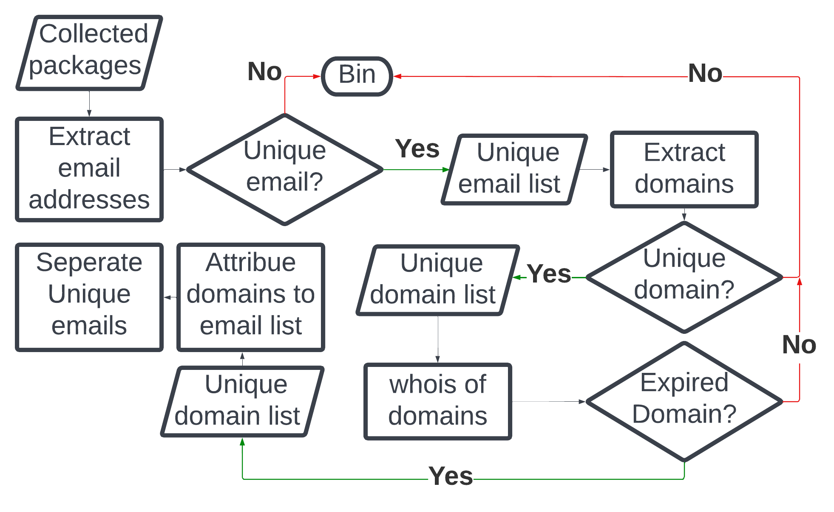

Slide 48
Research - npm packages (domains)
Significance? One maintainer or email address on average does maintain 11+ packages! If we divide total number of emails in the initial email address list with the sorted or unique email addresses we get 11+

Slide 49
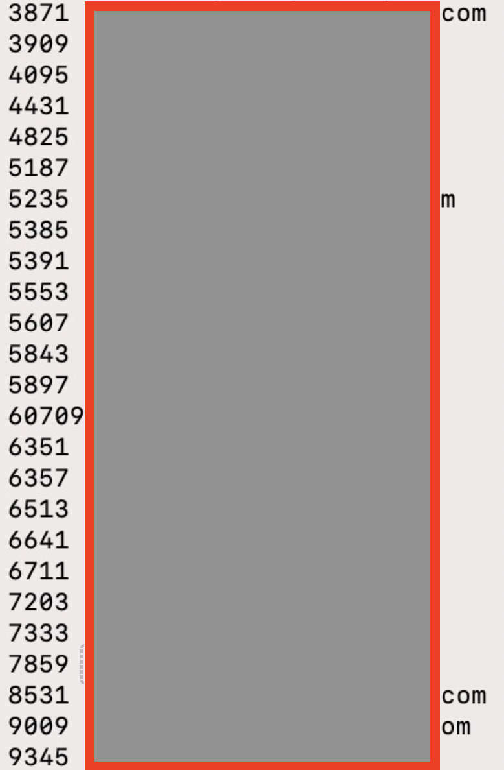
Research - npm packages (domains)
Significance?
25 email addresses were checked to identify the number of packages being maintained by them.
The numbers were eye-opening.
(Packages on right, Redacted emails on left

Slide 50
Research - npm packages (domains)
One maintainer or email address on average does maintain 11+ packages!
8973 email addresses occurrences of email addresses were take-overable according to the research and 845 were unique! (attribution of expired domains with unique email addresses)
Let’s multiply 845 with the number we got in previous slide (11+)
Average number of packages vulnerable

Slide 51
Research - npm packages (domains)
An additional step was taken at the end of this research in which the confirmed vulnerable packages were identified by attributing the email addresses of expired domains with the raw email list we got in Step 2.
2843 Packages were found vulnerable to this attack.

Slide 52
Research - npm packages (domains)
Significance ?
Remember that web of dependencies of dependencies, Danish displayed ?
Packages do depend on other packages and so on. It means even if you are using X package but if it is depending on Y package, your company is at risk due to Y package as well !
It’s an ocean of vulnerable dependencies actually! (due to supply chain). (200K+)
Millions of downloads for those vulnerable packages!

Slide 54
Gap that could be filled
Data breaches
There are hundreds of data breaches happening on the regular basis.
Plenty of data breaches data dump are available to public.
What if maintainer email is present in any data dump ?
What if the password of his other account is similar to that of software registry ?

Slide 55
Ruby Gems Research Approach

Slide 56
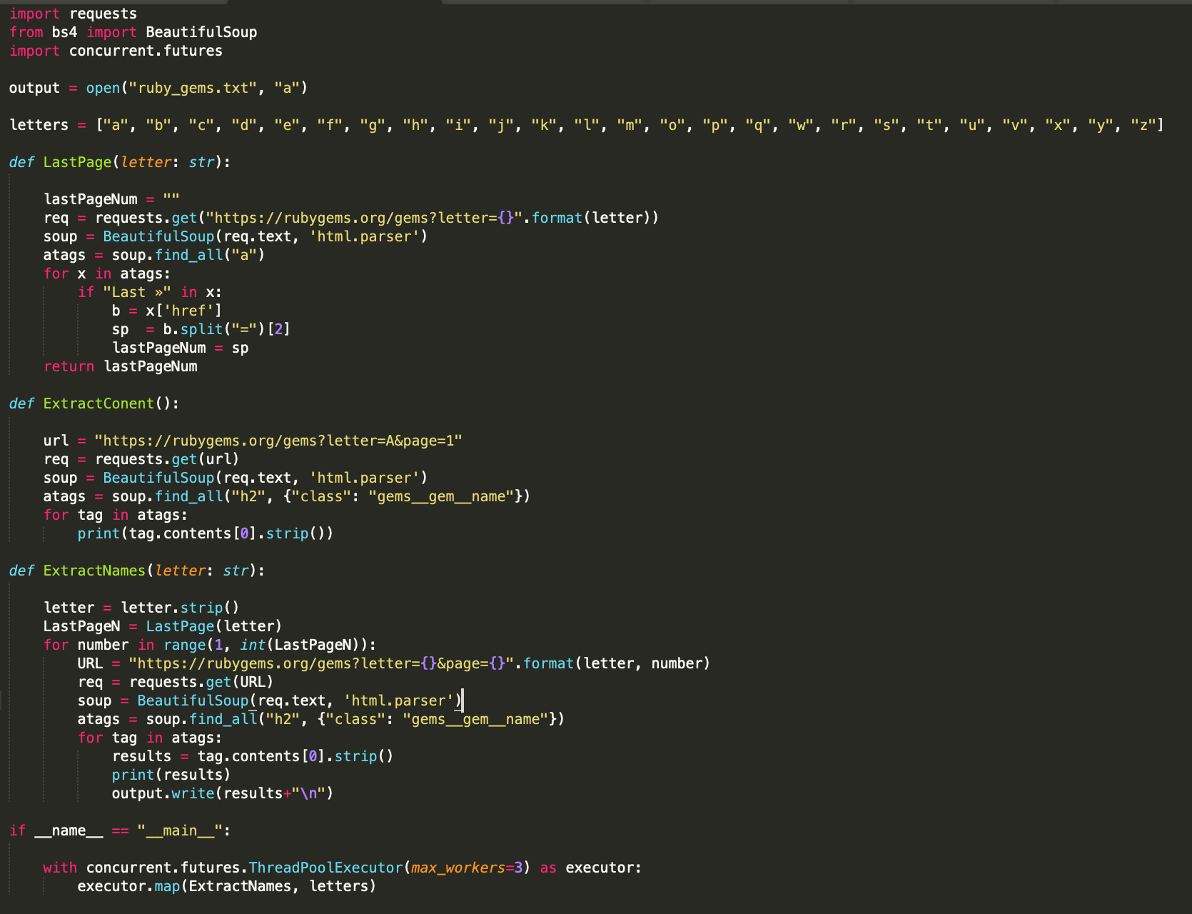
2 # Rails Gem Research Stats
Total Ruby Gems Identified: 160,953
https://rubygems.org/gems
https://gist.github.com/Splint3r7/c5aa692ea50365552932f56ab08a4e00

Slide 57
Rails Gem Research Approach
This time we researched openly disclosed dependencies available on Github and Bitbucket

Slide 58
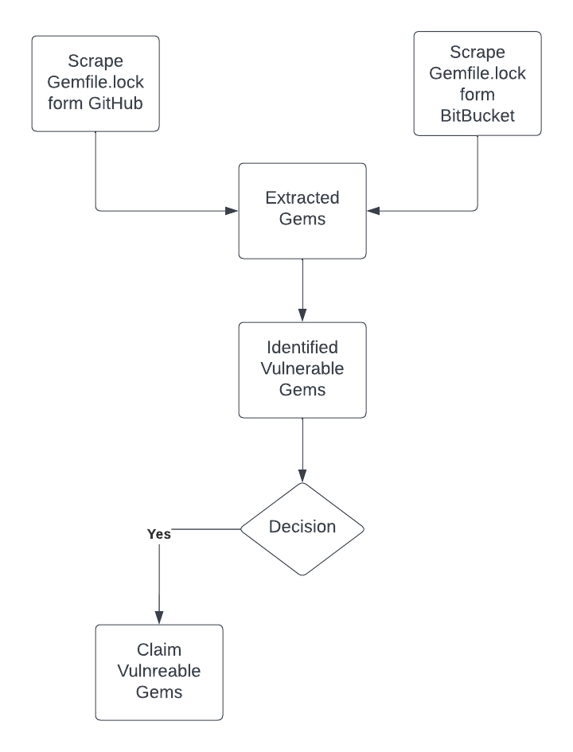
Approach

Slide 59
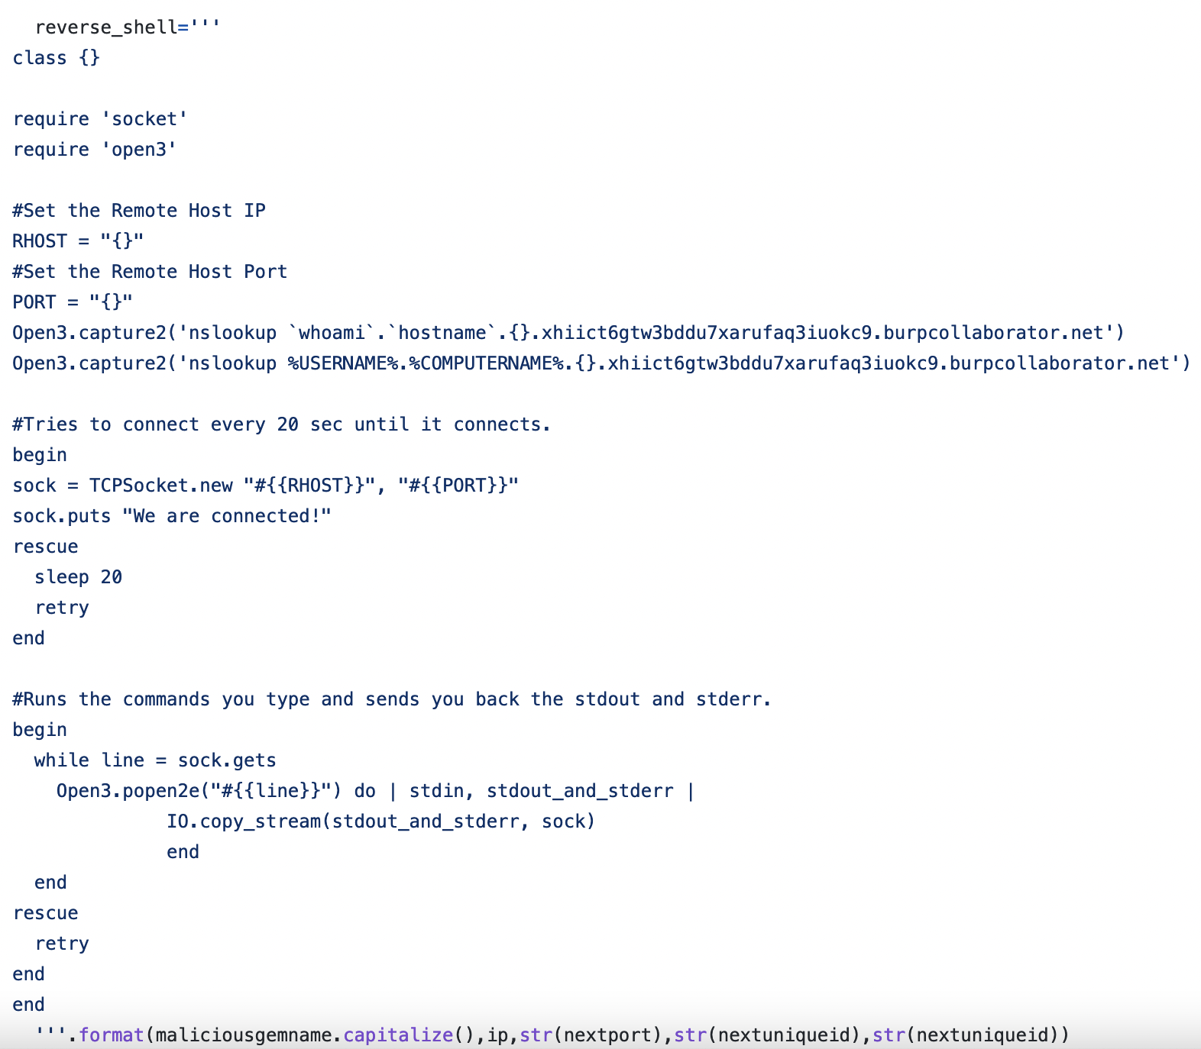
Vulnerable Ruby Gem
https://github.com/Splint3r7/rails-research/blob/main/confusedgem.py credits @Splint3r7/@Stark0de

Slide 60
Hardest Part!

Slide 61
Some Fun stuff!
1700 Gems Scanned
285 Gems Found to be Vulnerable/Claimable
16% of the gems were vulnerable.

Slide 62
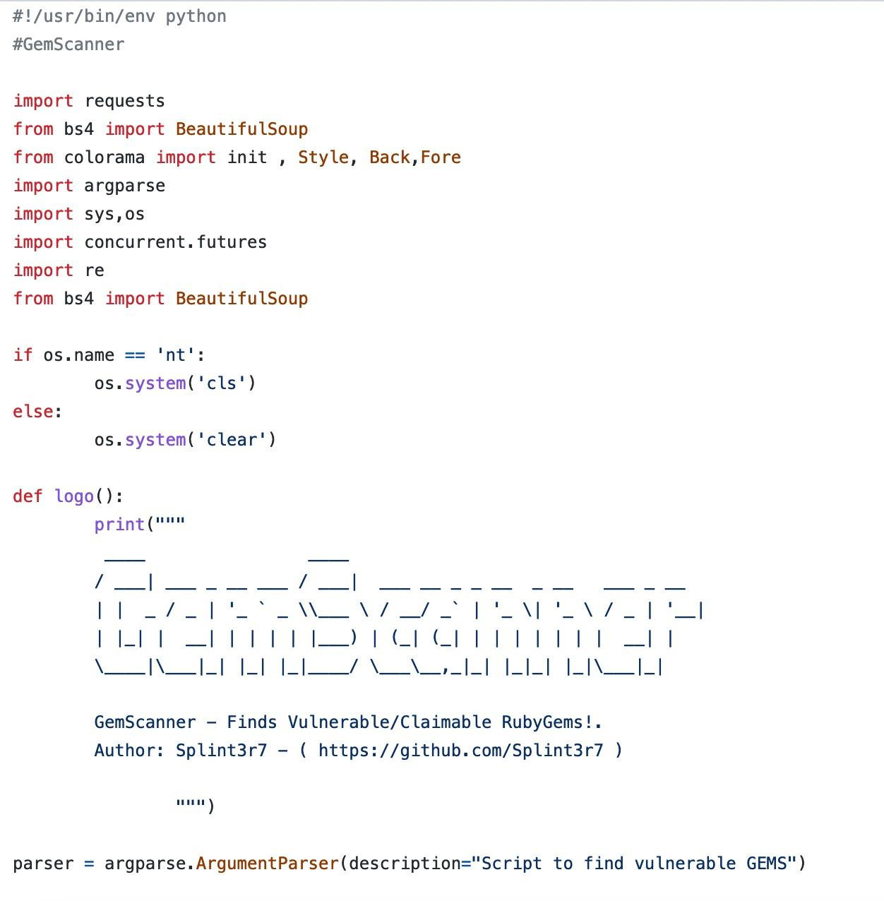
Script to detect dependency confusion
https://github.com/Splint3r7/rails-research/blob/main/rubygem_404/Dconfusion.py

Slide 63
Another tool for another problem

Slide 64
GemScanner
GemScanner identifies depreciated versions of gems in your ruby on rails project and notifies about their latest version.
Most of the tools or integrations notifies the developers of new gems when there are publicly disclosed vulnerabilities/cve’s in those gems. It solves that problem by just notifying of ANY update.
Usage
Notes:
It takes out Gems from your Gemfile.lock.
Identifies the current version and check if there is a new version and if so, it notifies you of that.
Results are then saved to a different text file.

Slide 65
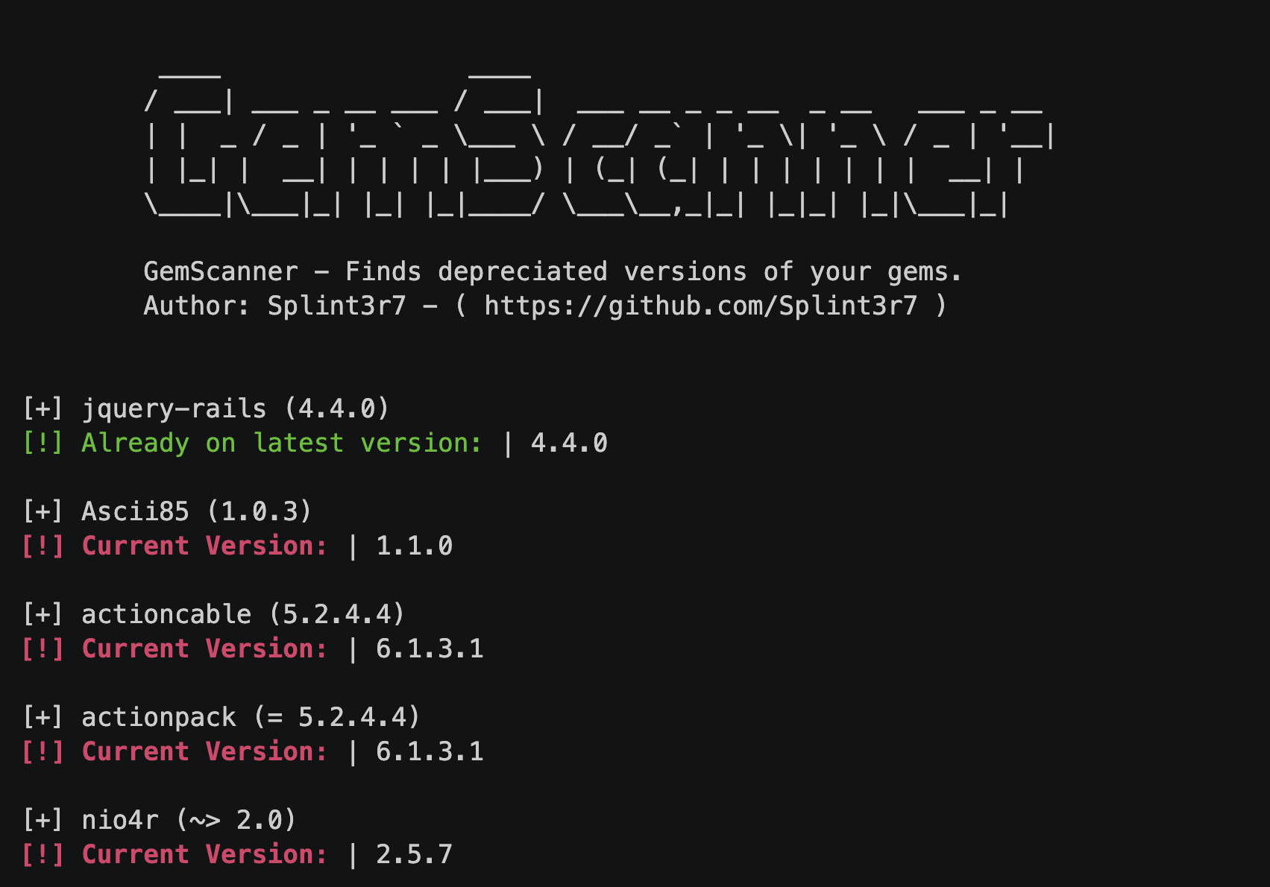
GemScanner
It takes out Gems from your Gemfile.lock.
Identifies the current version and latest version.
Results are then saved to a different text file.

Slide 66
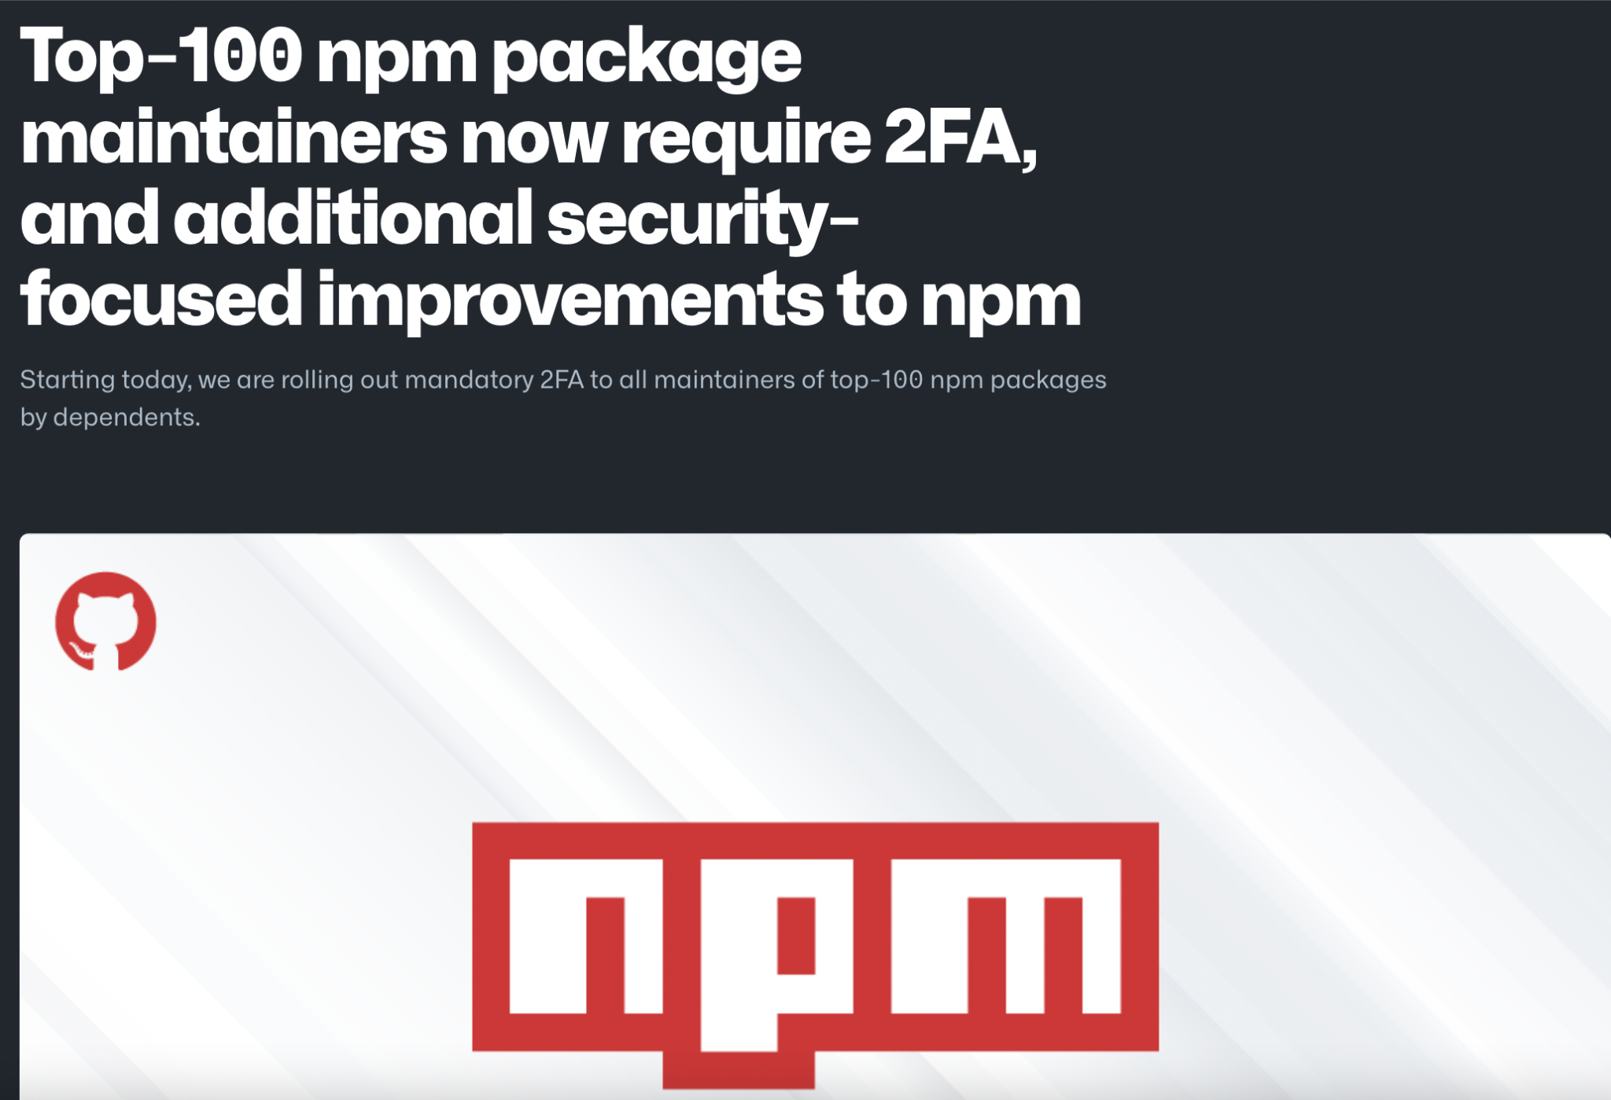
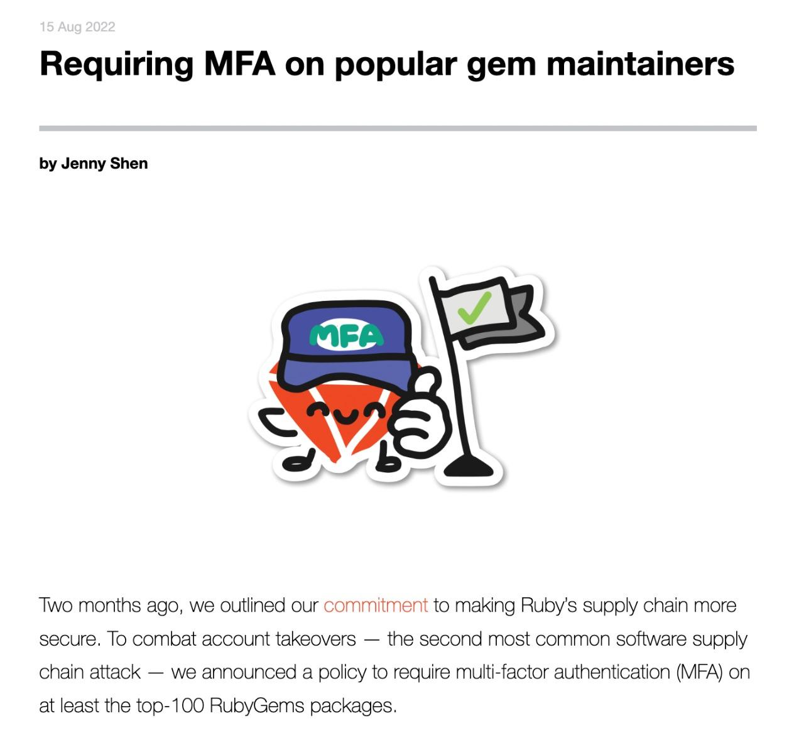
Solutions
MFA
Github blog
RubyGems blog

Slide 67
Solutions
For dependants
Keep your eyes open.
Be proactive!
Don’t trust any code piece available on the internet.
Use automations to keep the dependencies updated.
Implement a Zero Trust Architecture (ZTA)
Validate Checksums

Slide 68
Solutions
For dependants
Evaluate the security postures of the third parties.
Send and store regular third-party risk assessments.
Perform regular code reviews.
Make penetration testing part of your development lifecycle.
Keep on top of security bulletins.

Slide 69
Solutions
For dependants
Use dedicated tools to scan your dependency tree for security risks.
Github security alerts + Dependabot
GitLab security scanning
npm audit and retire.js for Node
bundler audit for Ruby.
OWASP dependency-check for Java and .NET
ShiftLeft + bundler-integrity

Slide 70
Solutions
SBOM
Implement SBOM (Software Bill Of Materials).
It includes the list of software components, version numbers, and metadata etc.
It could be used to track updates and vulnerabilities to stay vigilant!
It could do integrity checks and a lot of stuff to keep you secure.
It gives visibility!

Slide 71
Solutions
SBOM
There are commercial ones, but open-source SBOM could be used like a very well maintained CycloneDX and could be in combination with Dependency-track

Slide 72
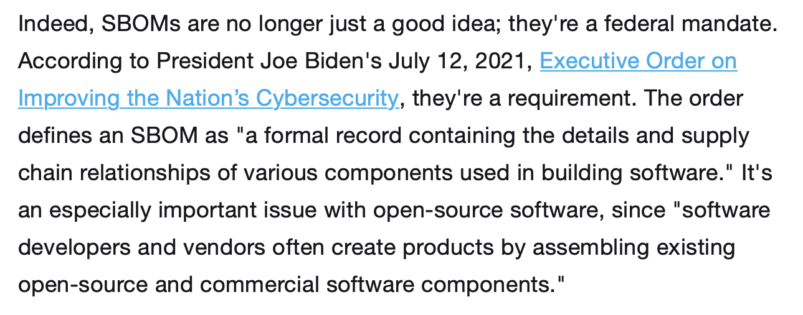
Solutions
SBOM
CSOonline.com

Slide 73
Any questions?

Slide 74
Thank You!

